Slide 1
Geosciences Node
Ed Guinness
MC Face-to-Face Meeting
Washington, DC
March 27-28, 2012

Slide 2
Web Presence
Geosciences Node Website
Community Forum
FTP Archive Access
Analyst’s Notebook (AN)
MER, Phoenix, LCROSS, Apollo
Planned for MSL
Mosaic and target viewer
Orbital Data Explorer (ODE)
Lunar, Mars, Mercury, Venus
Query Tools and Map Interface
Additional data sets
Spectral Library (In Development)

Slide 3
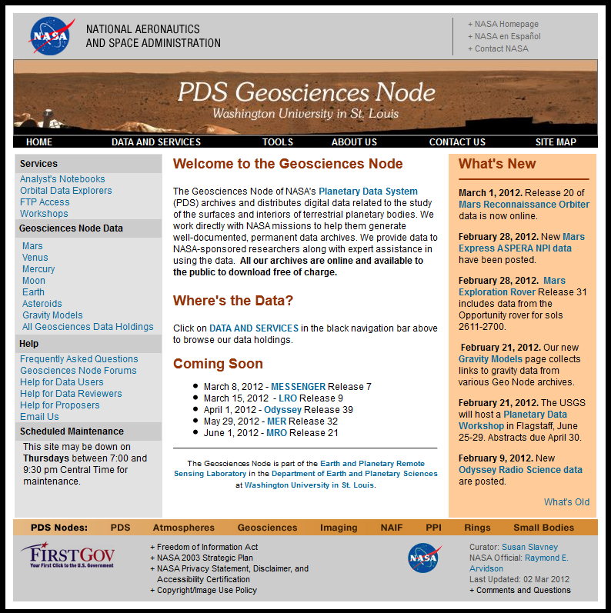
PDS Geosciences Website
The primary portal for information and direct HTTP access to the PDS Geosciences Node Archives.
March 1, 2011- February 29, 2012
Page Views
Total Page Views | 1,548,336
Average Page Views per Day | 4,230
Average Page Views per Visit | 6.48
Visits
Total Visits | 238,929
Average Visits per Day | 652
Total Unique IPs | 92,377
Average Visitor Stay Length | 12:05
Data Downloaded
Total Data Downloaded | 33.41 TB
Average per Day | 91.28 GB
Average per Visit | 146.64 MB
http://pds-geosciences.wustl.edu/

Slide 4
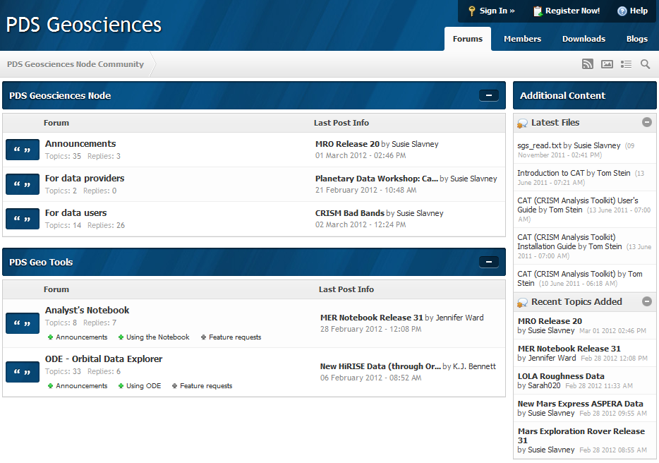
Community Forum
PDS Geosciences Node’s Community Forum provides a convenient location for posting news, tutorials, and answering user questions.
http://geoweb.rsl.wustl.edu/community/

Slide 5
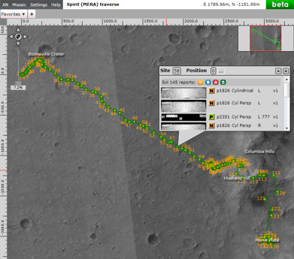
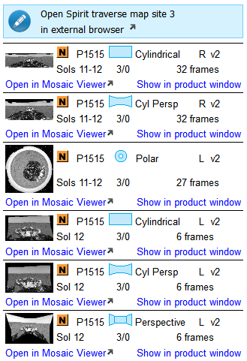
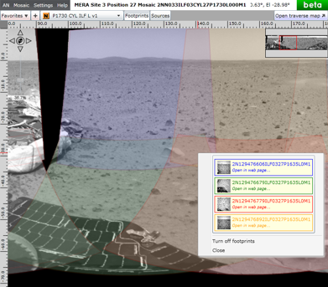
Analyst’s Notebook Mosaic Viewer
High resolution traverse maps and mosaics.
Zoom on demand.
Links to other MER data.
Easy file download.

Slide 6
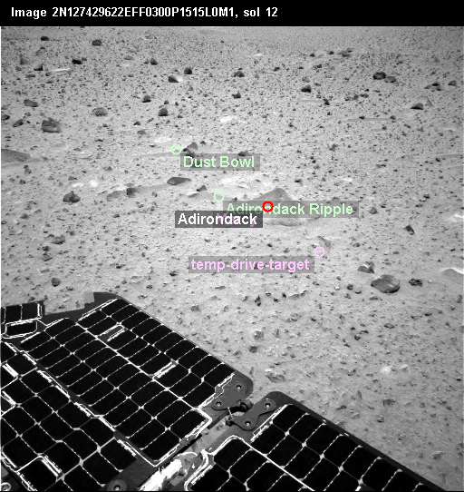
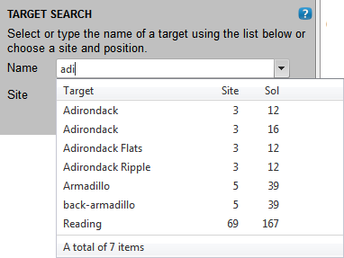
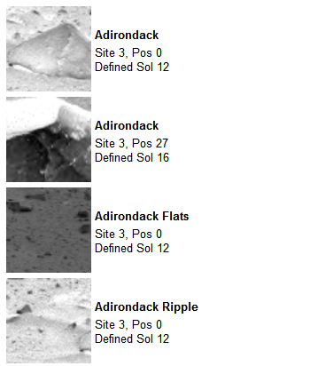
AN Target Viewer
Targets are now integrated in the Notebook.
Search by name, sol, or site/position.
View targets plotted on locator frames.
Find related targets and images.

Slide 7
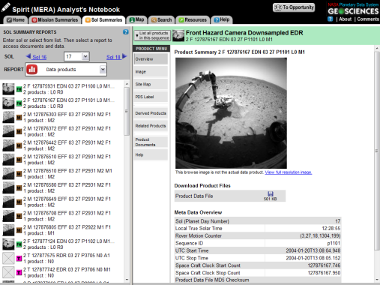
Analyst’s Notebook Plans
Improve search function to allow integrated searching of targets and documents.
Provide additional data format transformations.
Improve download function.

Slide 8
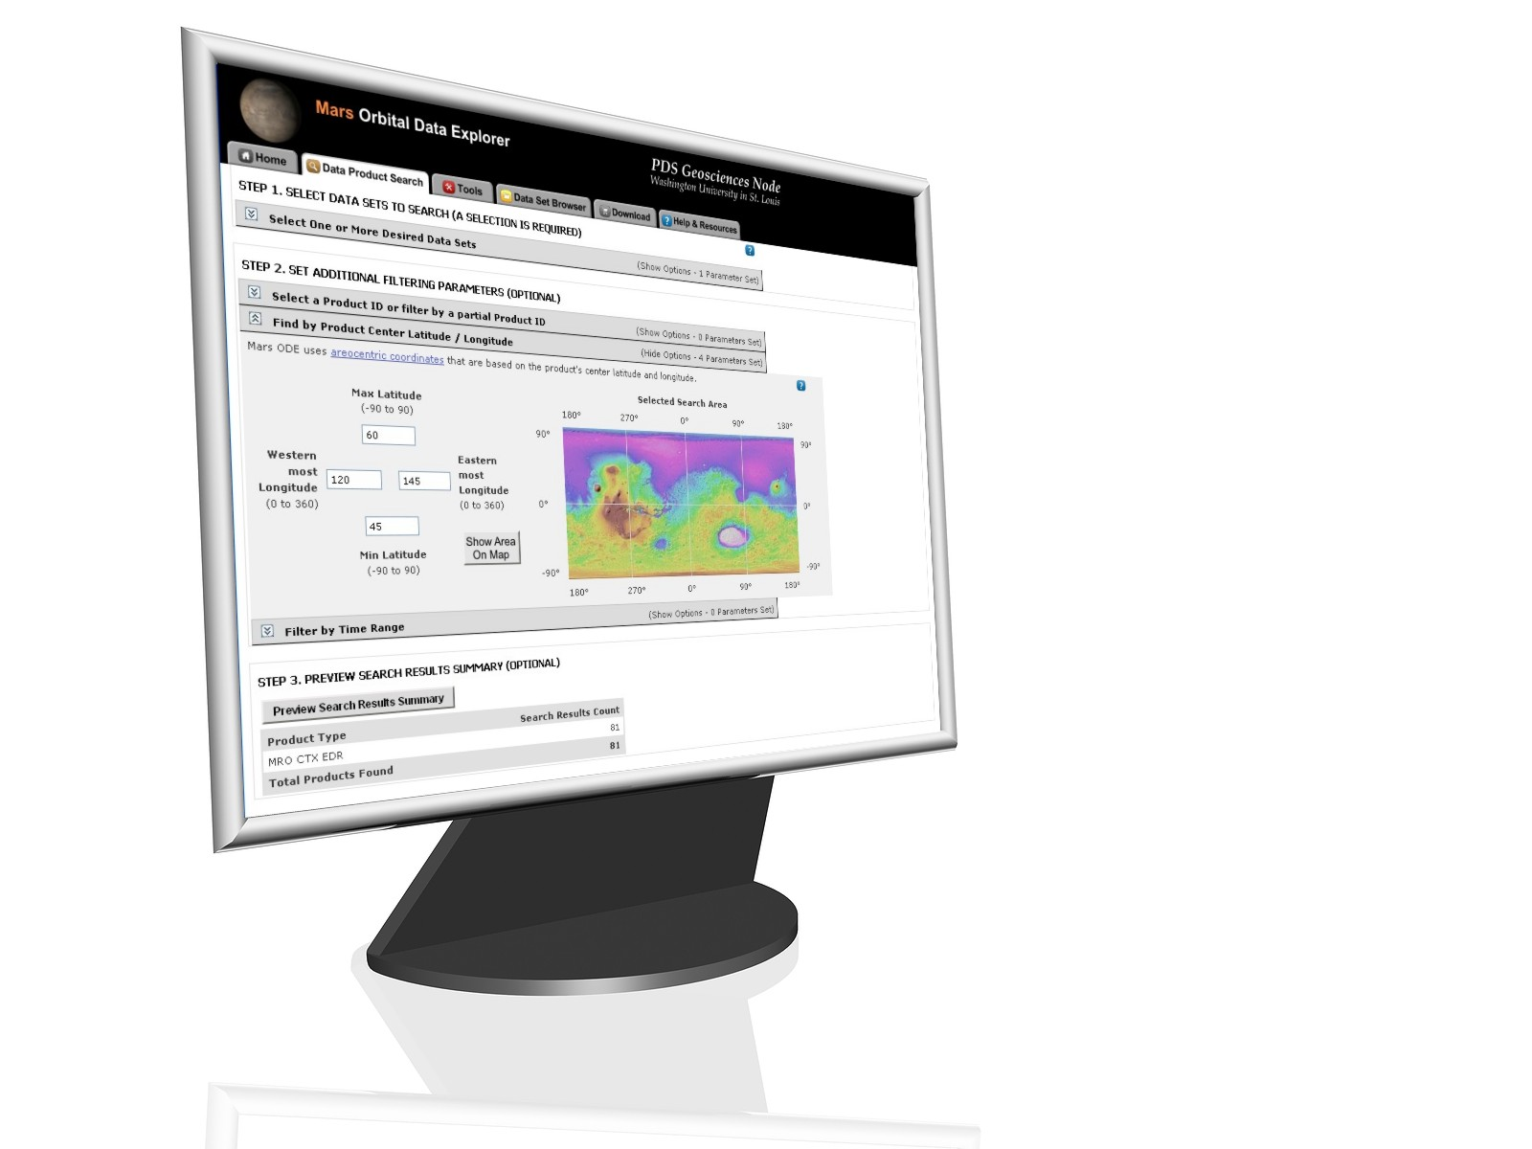
Orbital Data Explorer
Web interface for searching orbital data observations.
New data sets in ODE.
Odyssey GRS and THEMIS (in review).
Viking Orbiter Camera.
Chandrayaan-1 Mini-RF.
Lunar Orbiter Camera.

Slide 9
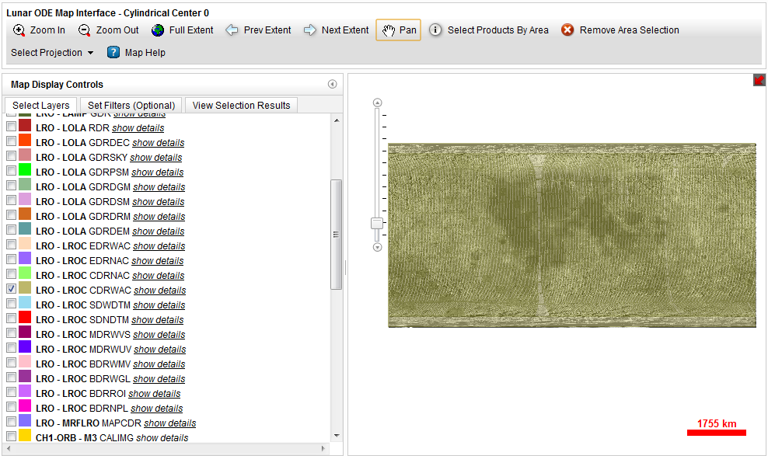
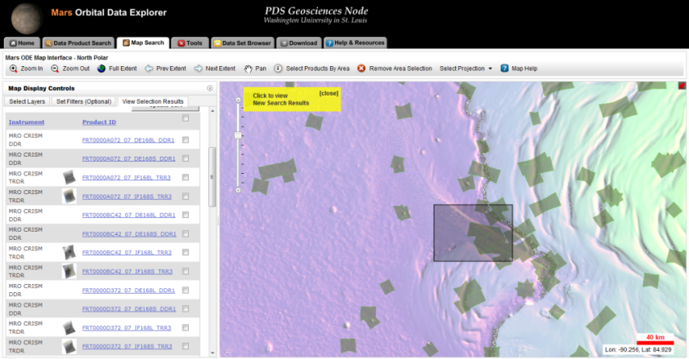
Orbital Data Explorer Map Interface
Interactive map interface was released in November 2011.
Provides functionality for viewing data product footprints on several basemaps.
Search for data products by region and by named features.
View selected products.

Slide 10
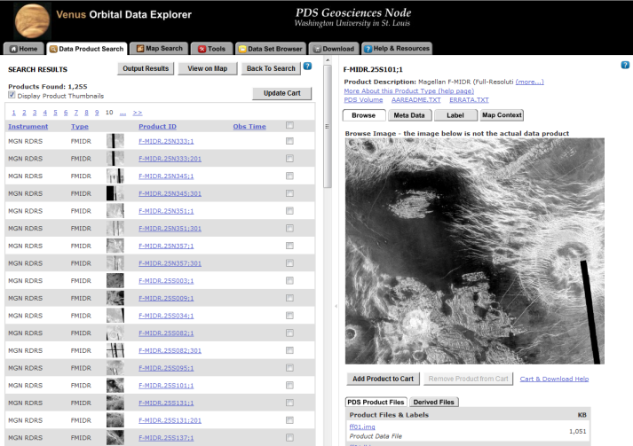
ODE for Venus
Currently under development. Expect public release by June 2012.
Initial release will include F-MIDR, Cx-MIDR, and possibly other data sets.

Slide 11
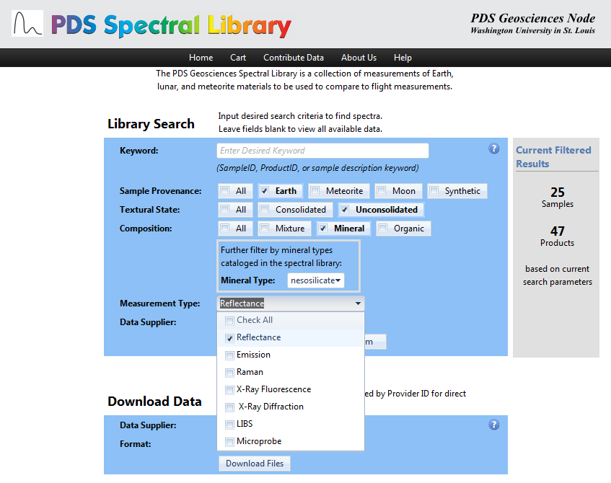
Spectral Library
Search by keyword, sample classification, data type, or data provider.
Data types supported will include:
Reflectance, Emission, Raman, X-Ray Fluorescence, X-Ray Diffraction, LIBS, Microprobe.

Slide 12
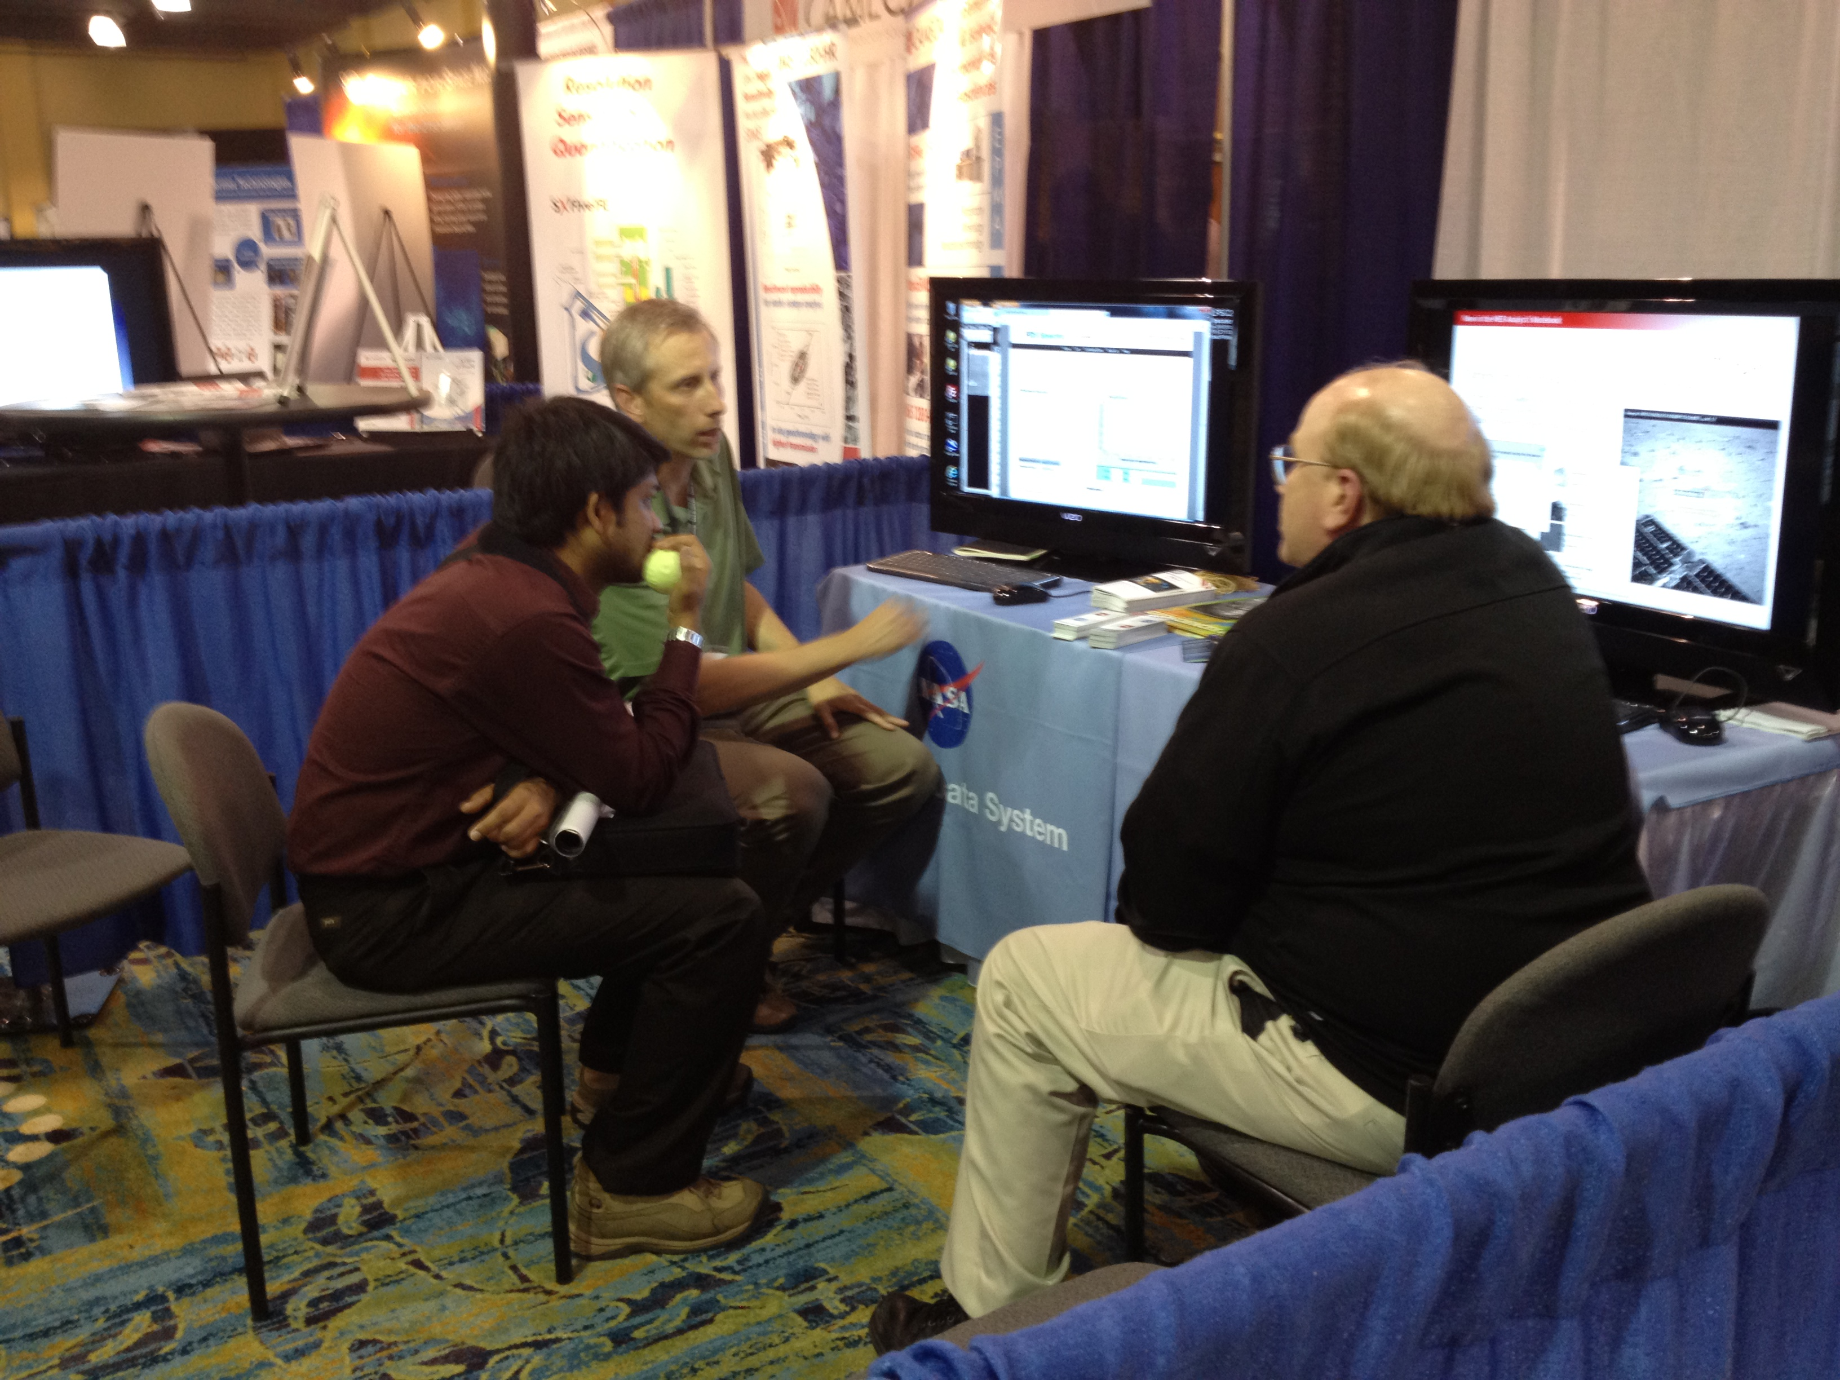
Meetings and Workshops
CRISM Team Data Users’ Workshop, March 18, 2012.
Supported workshop by presenting how to acquire CRISM data through ODE.
Prototype MTRDR products were included in ODE for the workshop.
LPSC, March 19-22, 2012.
Demos of AN and ODE and new tools that we are developing.
Received feedback on tools and suggestions for adding new features.

Slide 13
Mission Work: Active Missions
Active missions delivering data to Geosciences.
Mars – Odyssey, MER, Mars Express, and MRO.
Mercury – MESSENGER.
Moon – LRO.
Deliveries for these missions are going smoothly.
We average at least one delivery each month, sometimes more.

Slide 14
Mission Work: Mars Science Laboratory (Curiosity)
Background
MSL landing is Aug. 5, 2012.
First data release is Feb. 27, 2013, then a release every 90 sols.
Ten science instruments plus engineering instruments, data to be archived at Geo, Img, Atm, and PPI.
OPGS (Operations Product Generation System) creates all operations products and all instruments’ EDR products (except MSSS cameras).
Status
All teams are behind schedule. Some are WAY behind schedule. The 3 MSSS cameras don’t even have a schedule.
A few peer reviews have been started. None has finished. Teams and OPGS are very slow to respond to liens.
End-to-end delivery tests with PDS should begin this summer, but most teams have nothing ready to test.
PDS and Project Deputy Scientist Joy Crisp have tried to integrate archive development with Project schedule, but archiving gets very low priority.

Slide 15
Mission Work: GRAIL
Background
GRAIL began collecting data from lunar orbit March 7, 2012
First data release is Dec. 13, 2012, second release Oct. 11, 2013.
Twin spacecraft generate radio science data that are used to create gravity data products.
Both types to be archived at Geosciences Node.
Dick Simpson serves as our Radio Science advisor.
Status
Archive development schedule was revised when work got behind.
GRAIL team is editing Archive Volume and Data Product SIS.
Delivery to PDS for review expected by March 30.

Slide 16
NSSDC Deliveries
To date 2,339 distinct volumes have been delivered to NSSDC.
Includes data sets that are no longer accumulating.
Began processing first accumulating data sets, which will include 223 volumes (~650GB).
These volumes consists of Odyssey Radio Science and MER (Spirit) data.

