Slide 1
NAIF Node Report Addresses both NAIF Node and SPICE Development
PDSMC
March 27, 2012
SPICE components are not restricted under ITAR
Notes:
1

Slide 2
NAIF Funding Sources for FY12
Percent of Total Available Funds
Flight Projects 42%
NAIF Node 25%
SPICE development 22%
AMMOS* 11%
The PDS funds:
SPICE Development
NAIF Node
*Advanced Multi-Mission Operations System

Slide 3
NAIF Flight Project Funding

Slide 4
Archive Status - 1
Mars Odyssey
Cassini
MER Rovers
MRO
MESSENGER
New Horizons
Mars Express (ESA)
Venus Express (ESA)
Rosetta (ESA)
LRO
EPOXI
DAWN
MSL
Juno
GRAIL
Phobos-Grunt (RSA)
MAVEN
OSIRIS-REx
LADEE
• LADEE says it will deliver a SPICE
archive at the end of the mission.
Magellan
• NAIF can finish this partial, pre-PDS
archive; just need to find a bit more time.
Galileo
Phoenix
LCROSS
• NAIF can/will finish Galileo at some point.
• NAIF can make a Phoenix archive.
• AMES did not complete itsLADEE deliveries; NAIF can patch together enough to complete the job.
Good shape

Slide 5
Archive Status – 2 Archive sizes and covered time spans

Slide 6
NAIF Node Summary - 1
SPICE data archiving is in pretty good shape
Usually encounter problems with archives not produced at JPL
Occasionally we find a problem of our own
NAIF will shortly transfer the NEAR SPICE archive from SBN
Plan to do a major transformation of all archived SPICE data to PDS4 standards when PDS4 is stable and ready for ingest
Will correct a few current issues at the same time
User consulting continues to be a big part of NAIF staff daily work

Slide 7
NAIF Node Summary - 2
Updates to the SPICE Tutorials were recently completed
SPICE Training
The next SPICE training class will be in April, near Madrid
Around 81 students applied; ESA accepted only 42 due to space limitations
The next domestic class will probably be scheduled for later this year
Still need to break the curriculum into at least two chunks:
beginner
advanced

Slide 8
SPICE Development Summary - 1
Major recent focus is producing the N65 SPICE Toolkit
Due out in April
Contents:
New “geometry finder” functions
New high-level observation geometry routines
Important augmentations to some utility programs
New SPK and CK data types (one of each) to handle eventual problems with some large archive collections
Additional Icy (IDL) and Mice (MATLAB) routines
Lots of smaller items
Some bug fixes
After ~three months hiatus WebGeocalc development has been re-initiated

Slide 9
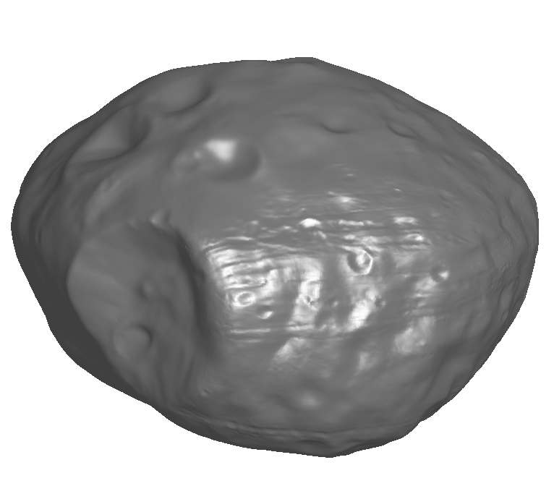
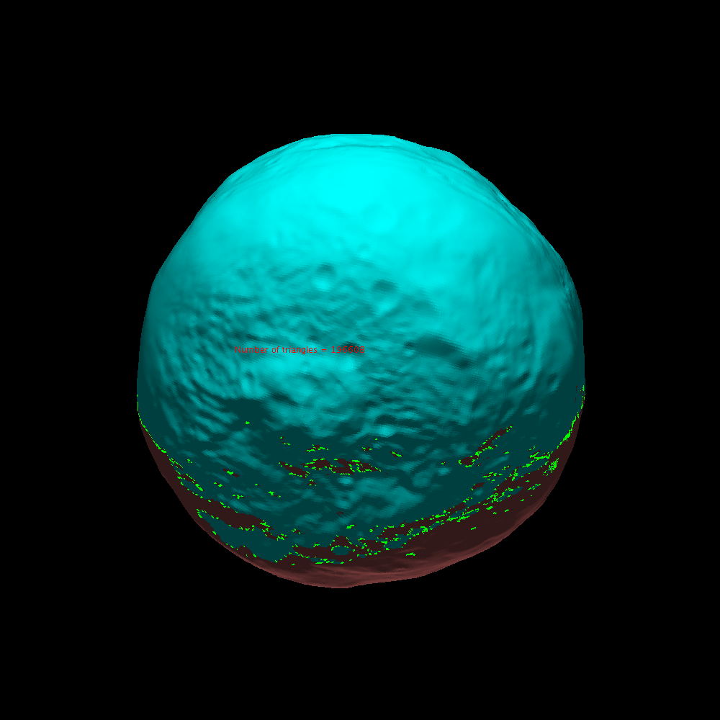
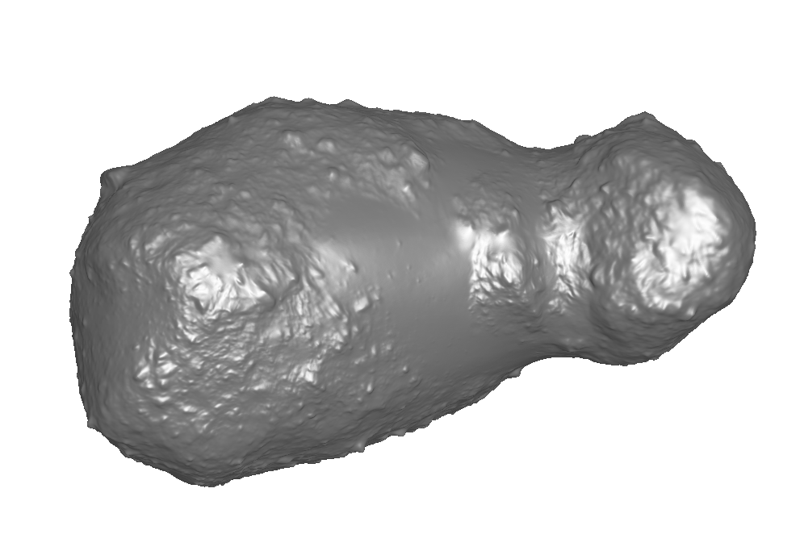
SPICE Development Summary - 2
Other SPICE development work (on hold in recent months)
Java Native Interface (JNI) Toolkit
Alpha-test version is already being used by several groups
New shape models
Digital terrain model
Tessellated plate model
Already in use on Hayabusa, DAWN, Rosetta, MEX and PhSRM
Phobos
Vesta
Itokawa

Slide 10
SPICE Development Summary - 3
The Planetary Ephemeris Working Group of IAU Commission IV has proposed to adopt (and adapt) SPICE as its standard, especially to facilitate comparisons of the planet ephemerides produced by NASA (JPL), France (Observatoire de Paris) and Russian (Institute of Applied Astronomy).
Details to accommodate this are still being worked out, but it now appears this can be done.
Expect a full “Go or no go” vote quite soon
There is already some talk of eventually including satellite, comet and asteroid ephemerides.

Slide 11
AMMOS* Summary
AMMOS funds two NAIF activities:
“Sustaining”
Funds used to port the Toolkit to new environments, and to accommodate infrastructure changes
“Repair”
Funds used to zap bugs
Much of these funds go unused
*Advanced Multi-Mission Operations System

Slide 12
Flight Projects Summary - 1
NASA Flight Projects
(not funded by PDS)
Ongoing SPICE operations for NASA flight projects are generally going well
Odyssey, MER, MRO, Epoxi, Cassini, Dawn, LRO, Messenger, New Horizons, Juno, MSL, GRAIL
Upcoming NASA missions set to use SPICE are:
MAVEN, SMAP (earth science) and OSIRIS-REx
LADEE will not use SPICE in ops, but claim they will produce/deliver a SPICE archive
Archive production by missions is generally going well

Slide 13
Flight Projects Summary - 2
International Flight Projects
(A mixed bag of funding)
ESA
MEX, VEX, Rosetta SPICE archives are trickling in
BepiColombo and Solar Orbiter seem very likely to use SPICE
ExoMars and others are TBD
ISRO
Said they want more SPICE training, but no recent dialogue
RSA
Cooperation on Phobos Sample Return was good
Support for Luna-Resurs (for both RSA and ISRO) will be proposed to NASA, if a SALMON or similar opportunity opens up
JAXA
Unclear as to future SPICE use, but some use seems likely given past experience
“China”

Slide 14
Question for PDSMC
?
Should PDS (and IPDA) strive to have “all” instrument teams create at least a minimal, quasi-standard set of consistent observation geometry parameters*, to be placed in product labels and extracted into registries?
To be used in PDS4 data searches
To support data analysis when user’s don’t want/need to re-compute observation geometry parameters
Might be accomplished using something like the “geolib”* approach used on MEX and VEX
One big challenge: some parameters have different meaning, or are simply not applicable, depending on the type of instrument or type of mission
*geolib computes: orbit number, solar distance, sub-solar point, s/c-sun distance, s/c-target distance, optic axis surface intercept point, slant distance, phase/incidence/ emission angles, local true solar time, pixel scale (size) on surface.

