Slide 1

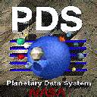
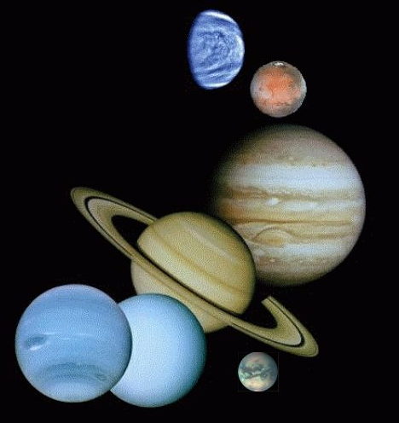

Planetary Data System Atmospheres Node
PDS MC F2F Report
Univ of Maryland
Mar 27, 2012
Reta Beebe
Lyle Huber
Nancy Chanover
Lynn Neakrase
Jim Murphy
Joni Johnson
Irma Trejo
Matias Roybal
Shannon Rees

Slide 2
Activities of Interest to Other Nodes
Transfer of data to NSSDC and the San Diego Super Computer Center
Completion of PDS Galileo and Cassini Jupiter data sets
Mars activity – Tie off of older Mars data sets – Retrieve atmospheric profiles from MRO radio science data
The need for bundling
Development for LADEE and MAVEN ( see Lyle’s presentation)
Improving Cassini Data Access

Slide 3
Transfer of data to NSSDC and San Diego Supercomputer Center
Joni Johnson has transferred NSSDC data to their data brick and has requested IDs for all sets. She encountered some transmission trouble transferring 158 Gb to SDSC
Completion of PDS Galileo and Cassini Jupiter data sets
We are assembling 2 high-order Jupiter Galileo and Cassini mapping data sets. Joni ran into problems with Vicar but has found Bob Dean/Imaging very helpful.

Slide 4
Tie off of older Mars data sets
Horizon Sensor MGS & Model assimilated reformatted TES data. Murphy is supervising.
Retrieve atmospheric profiles from MRO radio occultation experiments.
A significant quantity of radio occultation data has been collected with the MRO during the past 4 years. But no reduced data, such as atmospheric profiles, will be generated by the mission. In a small program Dave Hinson will modify software used on MGS and MEX and retrieve atmospheric profiles from a one month subset of MRO radio occultation data. He hopes to continue the effort in a DAP

Slide 5
PDS4 Development - The Need for Bundling
The nodes need to complete assembling a bundle to identify problems and allow migration to go forward.
Development for LADEE and MAVEN
See Lyle’s presentation
Improving Cassini data access
The flow-down scheme has been constructed on the assumption that Cassini team members should have direct access to instrument pages but novices should find resources that will allow them to slice and dice the data sets (See following slides).

Slide 6
Welcome to Cassini
Jupiter Flyby
Mission Definition
Specific Bodies
Fields & Particles
Apoapse Parameters
Periapse Parameters
Orbital inclination
Ring Plane Crossings
Dust Hazards
Occultations
Tour Plan(s)
Saturn
Rings
Icy Satellites
Rocks
Titan
Bowshock and Magnetopause
Crossings
Intervals when Cassini is in the
Magnetosphere
Orbital Inclinations
Targeted & Nontargeted Flybys
Occultations
Planning sheets
Instruments used
Instrument Information
Users’ Guide
SIS
Etc.
Access to Nodes & Data Sets

Slide 7
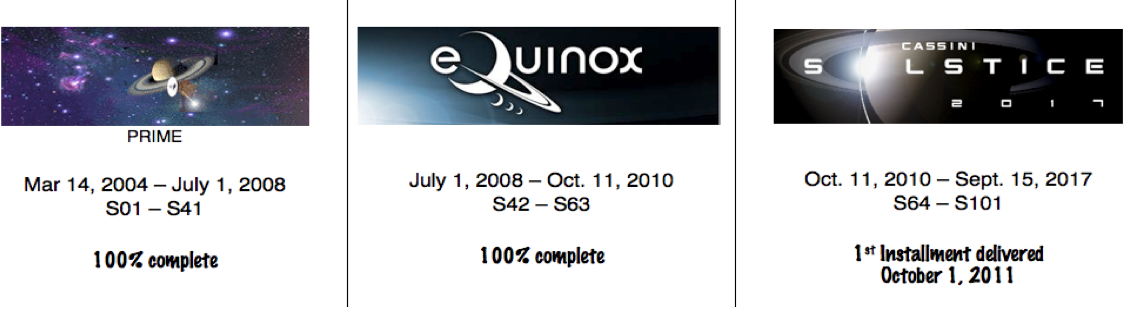
Welcome to the Cassini Archive Page
Cassini data are delivered to the PDS 9-12 months after acquisition and are delivered every three months. PDS must validate those data before they are considered certified. This may result in a delay between the time when Cassini delivers data and the time when PDS makes the data available. Alternately, PDS may choose to put data online while they are being validated, stating that they are not certified. PDS urges caution when using any data that have been released by the PDS for less than three months.
Organization of The Cassini Mission. The mission is divided into 4 phases: the Cruise Phase (including the Jupiter Flyby Dec 2000-Jan 2001), the Prime Mission, the Equinox Mission and the Solstice Mission. Data from all phases are stored sequentially in the PDS. Tables of times of apoapses and periapses, inclination plots, times of ring-plane crossings, dust hazards and dust crossings, Sun and Earth occultations for Saturn, Rings, Titan and Enceladus and times of conjunction will help you scope the mission.

Slide 8
Finding Cassini Data. Although the data from the various instruments are archived within the appropriate discipline nodes, it is assumed that the user would be interested in a specific body or in fields and particles data; hence, these web pages are set up to facilitate searches of this sort.
Note: These pages would be formulated with consultation with the instrument teams and the appropriate nodes. Every effort will be made to access material that is already on line in the PDS.
Understanding the Instrument and the Archived Data. In an effort to supplement the meager availability of higher-order reduced data products, the Cassini Instrument Teams are generating users’ guides to supplement the original documentation. Access to the guides and other useful information can be found at the following pages.
CAPS - Cassini Plasma Spectrometer
CDA - Cosmic Dust Analyzer
CIRS - Composite Infrared Spectrometer
INMS - Ion and Neutral Mass Spectrometer
ISS - Imaging Science Subsystem
MAG – Magnetometer
MIMI - Magnetospheric Imaging Instrument
RADAR - a Radar instrument
RPWS - Radio and Plasma Wave Spectrometer
RSS - Radio Science Subsystem
UVIS - Ultraviolet Imaging Spectrograph
VIMS - Visual and Infrared Mapping Spectrometer
Navigation and pointing information can be obtained at the NAIF site.

Slide 9
Welcome to Cassini
Jupiter Flyby
Mission Definition
Specific Bodies
Fields & Particles
Apoapse Parameters
Periapse Parameters
Orbital inclination
Ring Plane Crossings
Dust Hazards
Occultations
Tour Plan(s)
Saturn
Rings
Icy Satellites
Rocks
Titan
Bowshock and Magnetopause
Crossings
Intervals when Cassini is
in the Magnetosphere
Orbital Inclinations
Targeted & Nontargeted Flybys
Occultations
Planning sheets
Instruments used
Instrument Information
Users’ Guide
SIS
Etc.
Access to Nodes & Data Sets

Slide 10
Welcome to the Cassini Archive Page
Cassini data are delivered to the PDS 9-12 months after acquisition and are delivered every three months. PDS must validate those data before they are considered certified. This may result in a delay between the time when Cassini delivers data and the time when PDS makes the data available. Alternately, PDS may choose to put data online while they are being validated, stating that they are not certified. PDS urges caution when using any data that have been released by the PDS for less than three months.
Organization of The Cassini Mission. The mission is divided into 4 phases: the Cruise Phase (including the Jupiter Flyby Dec 2000-Jan 2001), the Prime Mission, the Equinox Mission and the Solstice Mission. Data from all phases are stored sequentially in the PDS. Tables of times of apoapses and periapses, inclination plots, times of ring-plane crossings, dust hazards and dust crossings, Sun and Earth occultations for Saturn, Rings, Titan and Enceladus and times of conjunction will help you scope the mission.

Slide 11
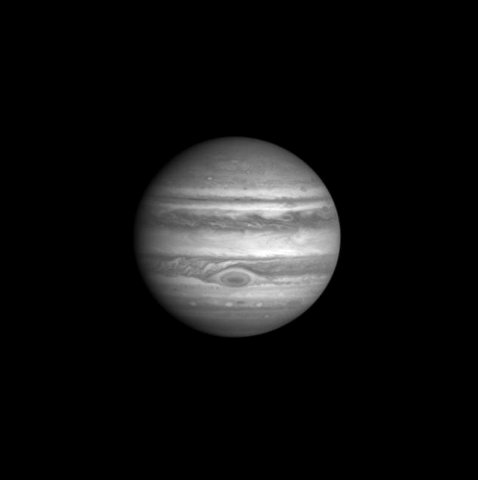
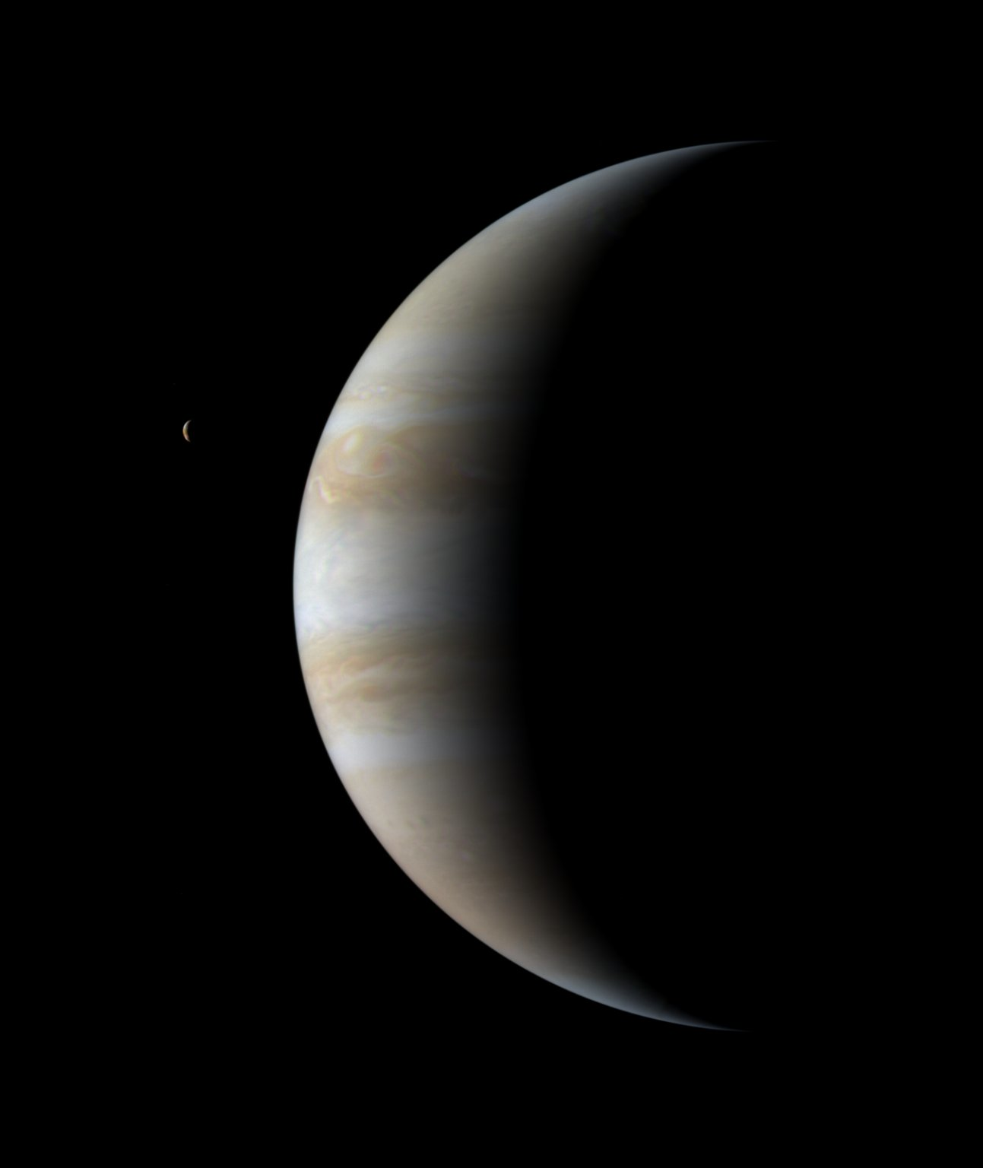
Jupiter Cassini Flyby
The Cassini Jupiter flyby closest approach occurred on December 30, 2000 at a distance of 10 million km.
Observations were made of:
Jupiter
Rings
Io
Europa
Ganymede
Callisto
First Image PIA02666
http://photojournal.jpl.nasa.gov/
The first image was obtained on Oct 1, 2000 and the last on Mar 22, 2001 with IR and UV observations in the interval. Global mapping of Jupiter spanned a period from Oct 1-Dec 9, 2000, followed by a period of intense observations.
Last Image PIA03451
http://photojournal.jpl.nasa.gov/

Slide 12
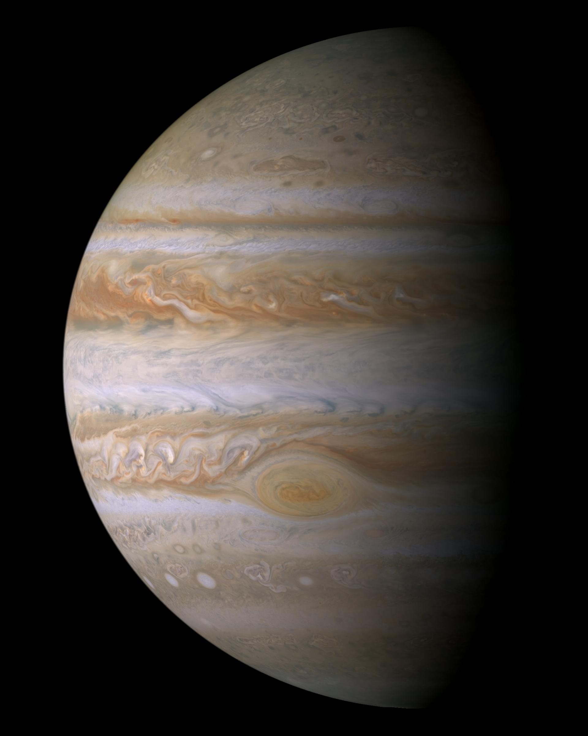
Jupiter Observations
The Cassini Jupiter flyby spanned the interval from Sept 26 2000-Jan 15 2001. Targeted Jupiter data was near closest approach (see log)
Observations were made by:
CIRS - Composite Infrared Spectrometer
see volume cocirs_0306
ISS - Imaging Science Subsystem
see Imaging Node QuickSearch
UVIS - Ultraviolet Imaging Spectrograph
see volumes couvis_0001 & couvis_0002
VIMS – Visual and Infrared Mapping Spectrometer
see Imaging Node QuickSearch
Cassini Image PIA04866.jpg
http://photojournal.jpl.nasa.gov/
Additional Assistance is available at the Rings Node
A log of “as planned” observations during the intense period of observations
Data Types
Raw – for all 4 instruments
Reduced - CIRS
Higher Order Products – ISS – A dynamical map sequence ????Conditionally on line at ????

Slide 13
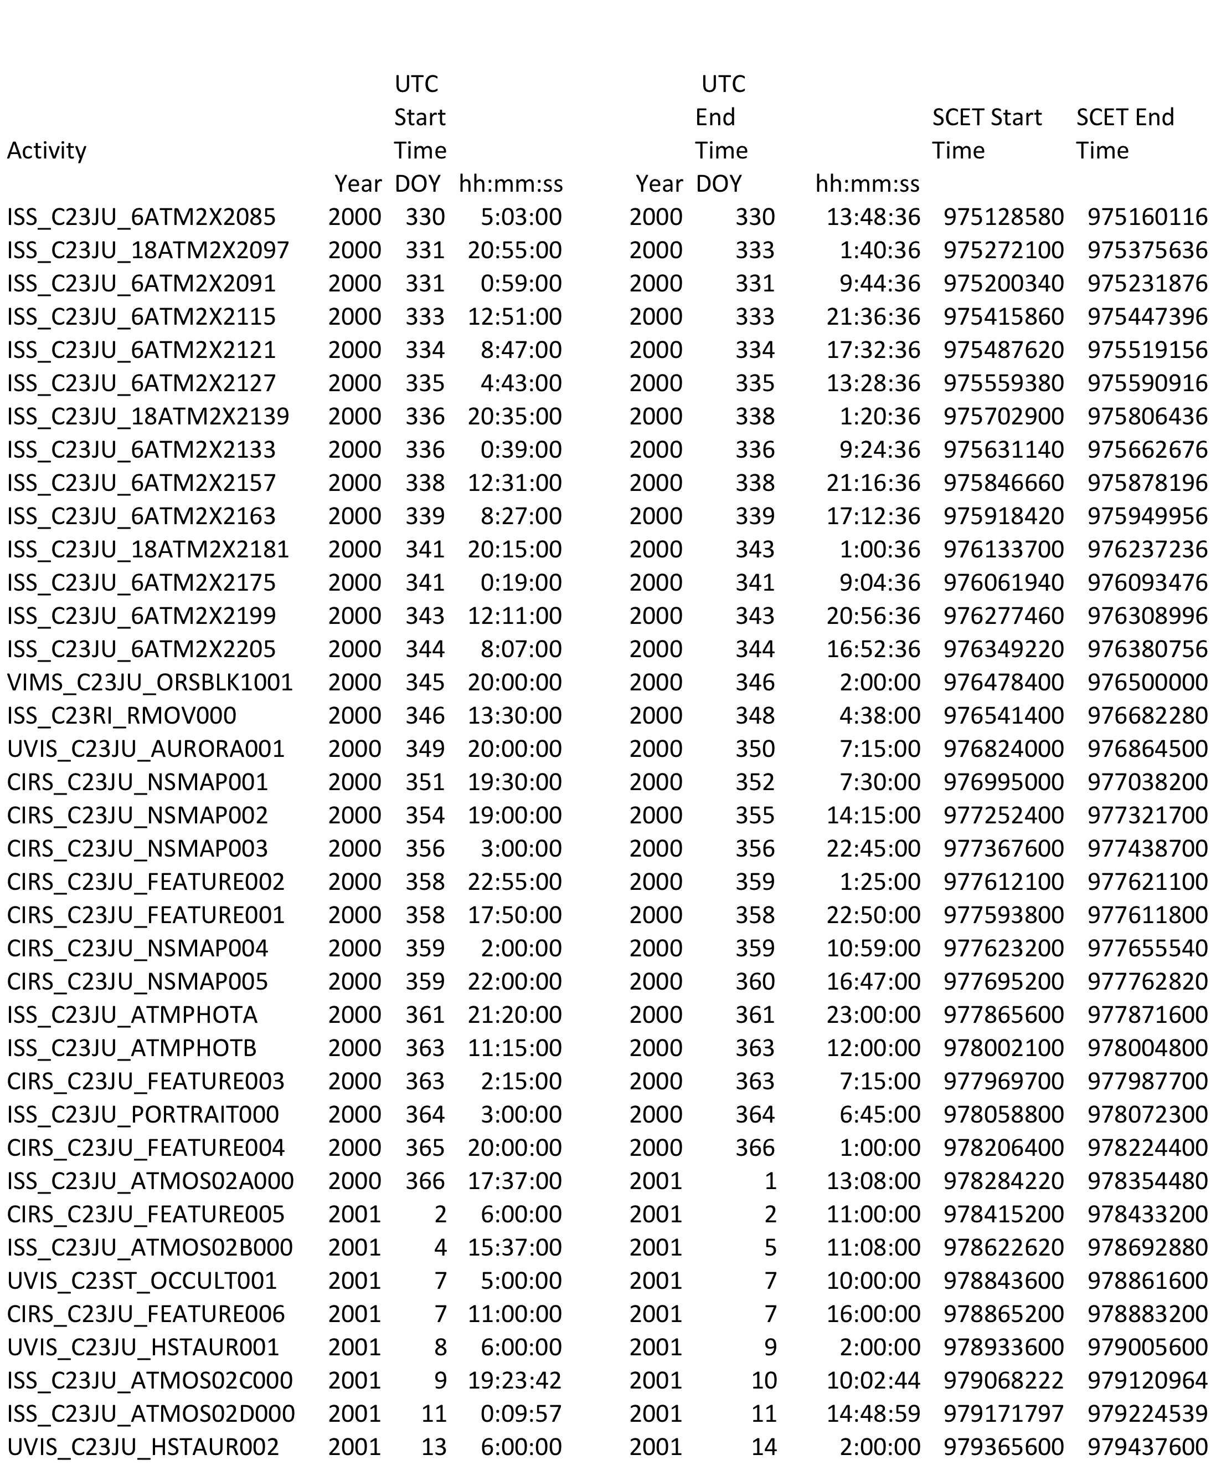
Jupiter Observing Log

Slide 14
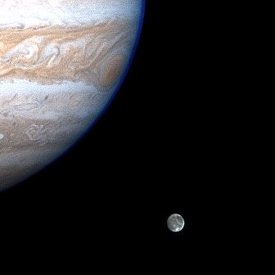
Ganymede Observations
The Cassini Jupiter flyby spanned the interval from Sept 26 2000-Jan 15 2001. Targeted Ganymede data was near closest approach (see log)
Observations were made by:
CIRS - Composite Infrared Spectrometer
see volume cocirs_0306
ISS - Imaging Science Subsystem
see Imaging Node QuickSearch
UVIS - Ultraviolet Imaging Spectrograph
see volumes couvis_0001 & 0002
VIMS – Visual and Infrared Mapping
Spectrometer
see Imaging Node QuickSearch
Cassini Image
http://ciclops.org
Additional Assistance is available at the Rings Node
A log of “as planned” observations during the intense period of observations
Data Types
Raw – for all 4 instruments
Reduced - CIRS

Slide 15
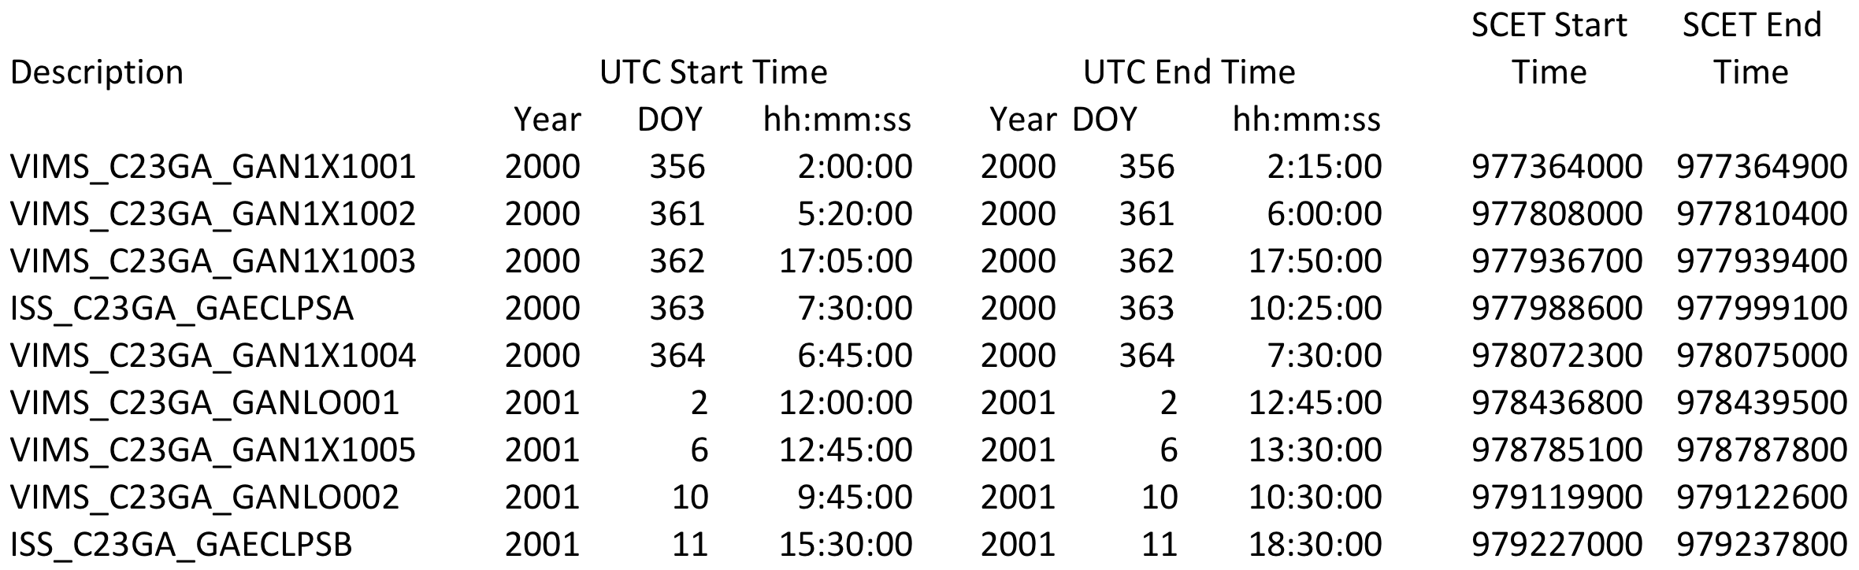
Ganymede Observing Log

Slide 16
Welcome to Cassini
Jupiter Flyby
Mission Definition
Specific Bodies
Fields & Particles
Apoapse Parameters
Periapse Parameters
Orbital inclination
Ring Plane Crossings
Dust Hazards
Occultations
Tour Plan(s)
Saturn
Rings
Icy Satellites
Rocks
Titan
Bowshock and Magnetopause
Crossings
Intervals when Cassini is
in the Magnetosphere
Orbital Inclinations
Targeted & Nontargeted Flybys
Occultations
Planning sheets
Instruments used
Instrument Information
Users’ Guide
SIS
Etc.
Access to Nodes & Data Sets

Slide 17
Welcome to the Cassini Archive Page
Cassini data are delivered to the PDS 9-12 months after acquisition and are delivered every three months. PDS must validate those data before they are considered certified. This may result in a delay between the time when Cassini delivers data and the time when PDS makes the data available. Alternately, PDS may choose to put data online while they are being validated, stating that they are not certified. PDS urges caution when using any data that have been released by the PDS for less than three months.
Organization of The Cassini Mission. The mission is divided into 4 phases: the Cruise Phase (including the Jupiter Flyby Dec 2000-Jan 2001), the Prime Mission, the Equinox Mission and the Solstice Mission. Data from all phases are stored sequentially in the PDS. Tables of times of apoapses and periapses, inclination plots, times of ring-plane crossings, dust hazards and dust crossings, Sun and Earth occultations for Saturn, Rings, Titan and Enceladus and times of conjunction will help you scope the mission.

Slide 18
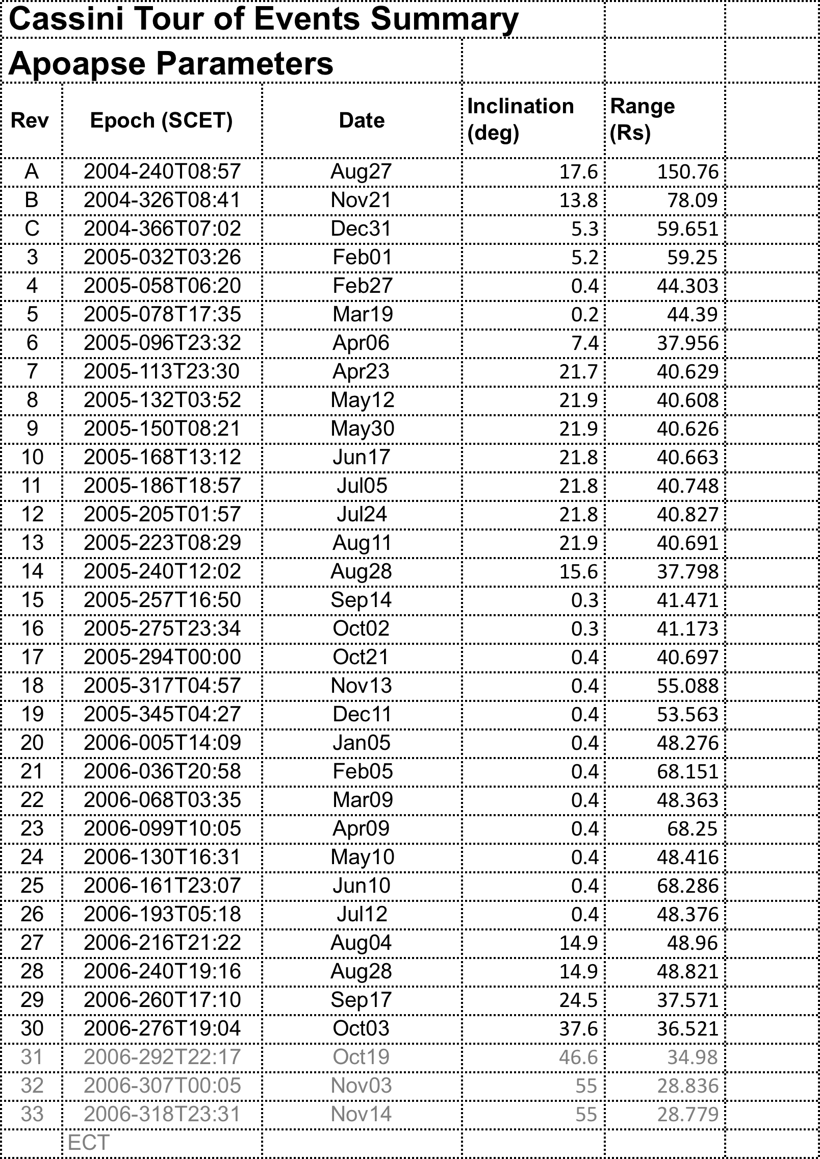

Slide 20
Welcome to Cassini
Jupiter Flyby
Mission Definition
Specific Bodies
Fields & Particles
Apoapse Parameters
Periapse Parameters
Orbital inclination
Ring Plane Crossings
Dust Hazards
Occultations
Tour Plan(s)
Saturn
Rings
Icy Satellites
Rocks
Titan
Bowshock and Magnetopause
Crossings
Intervals when Cassini is
in the Magnetosphere
Orbital Inclinations
Targeted & Nontargeted Flybys
Occultations
Planning sheets
Instruments used
Instrument Information
Users’ Guide
SIS
Etc.
Access to Nodes & Data Sets

Slide 21
Specific Saturnian Bodies
Small Satellites (rocks)
AEGAEON
ATLAS
CALYPSO
DAPHNIS
EPIMETHEUS
HELENE
JANUS
METHONE
PALLENE
PAN
PANDORA
POLYDEUCES
TELESTO
SATURN
RINGS
TITAN
Icy Satellites
PHOEBE
ENCELADUS
HYPERION
IAPETUS
MIMAS
RHEA
THETHYS
DIONE

Slide 22
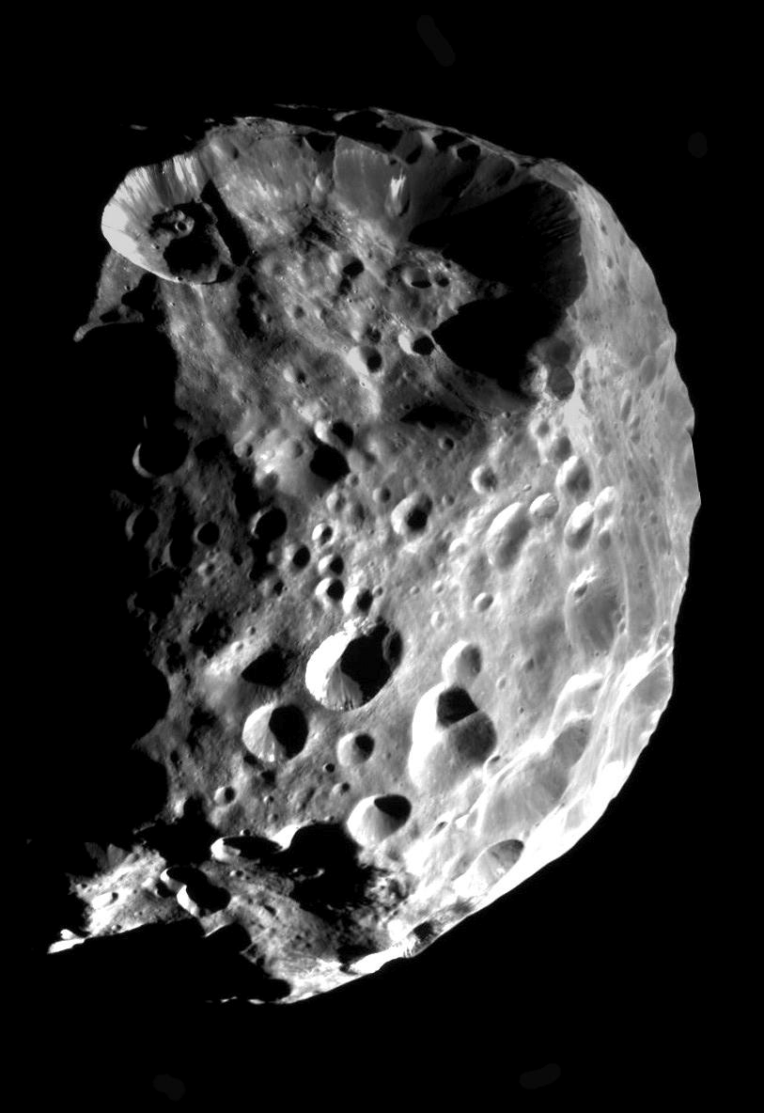
Phoebe Observations
Cassini encountered Phoebe on approach to Saturn. Data was obtained from June 11 4:40 to June 12 11:26, 2004 (observing log). (day 163-4, 2004)
Observations were made by:
CIRS - Composite Infrared Spectrometer
ISS - Imaging Science Subsystem
UVIS - Ultraviolet Imaging Spectrograph
VIMS – Visual and Infrared Mapping
Spectrometer
Data types
Raw - description
Reduced -???????
Higher Order Products - ??????
Image PIA06064.jpg
http://photojournal.jpl.nasa.gov/
Note—The data type pages would be formulated in close conjunction with the appropriate nodes. You can find the data associated with a body, download the table (see Phoebe_S1 - a table of “as-planned”– we would like “as-flown) and slice and dice it and then go to the instrument page or data set --. Every effort will be made to access material that is already on line in the PDS.

Slide 23
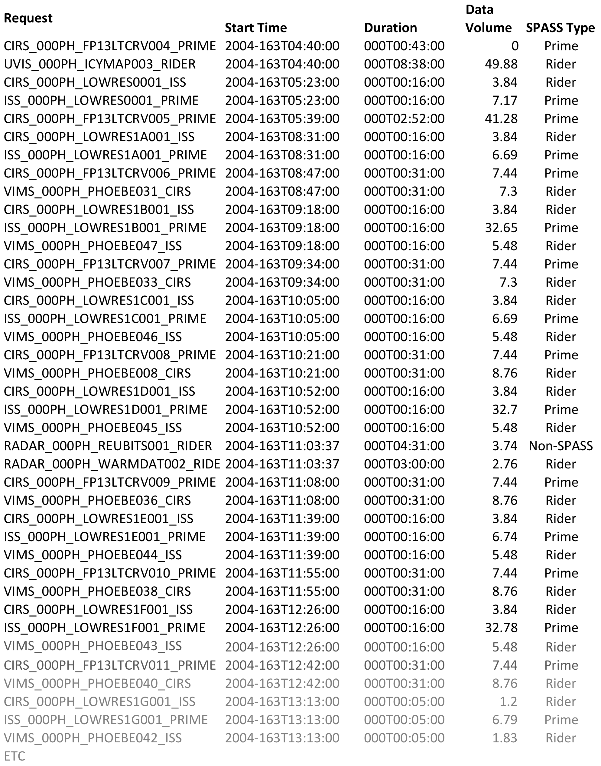
Phoebe Observing Log (As Planned)

Slide 24
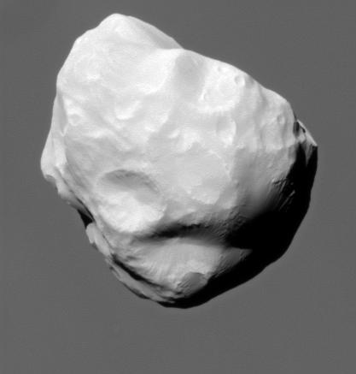
Helene Observations
Helene is a co-orbital satellite that is located in Dione’s leading L4 location .
It’s dimensions are 43.4 X 38.2 X 26 km.
Considerable coverage has been obtained, with more opportunities in the Solstice mission. See Tour Event Summary.
Image PIA12723.jpg
http://photojournal.jpl.nasa.gov/
Observations were made by:
CIRS - Composite Infrared Spectrometer
ISS - Imaging Science Subsystem
UVIS - Ultraviolet Imaging Spectrograph
VIMS – Visual and Infrared Mapping
Spectrometer

Slide 25
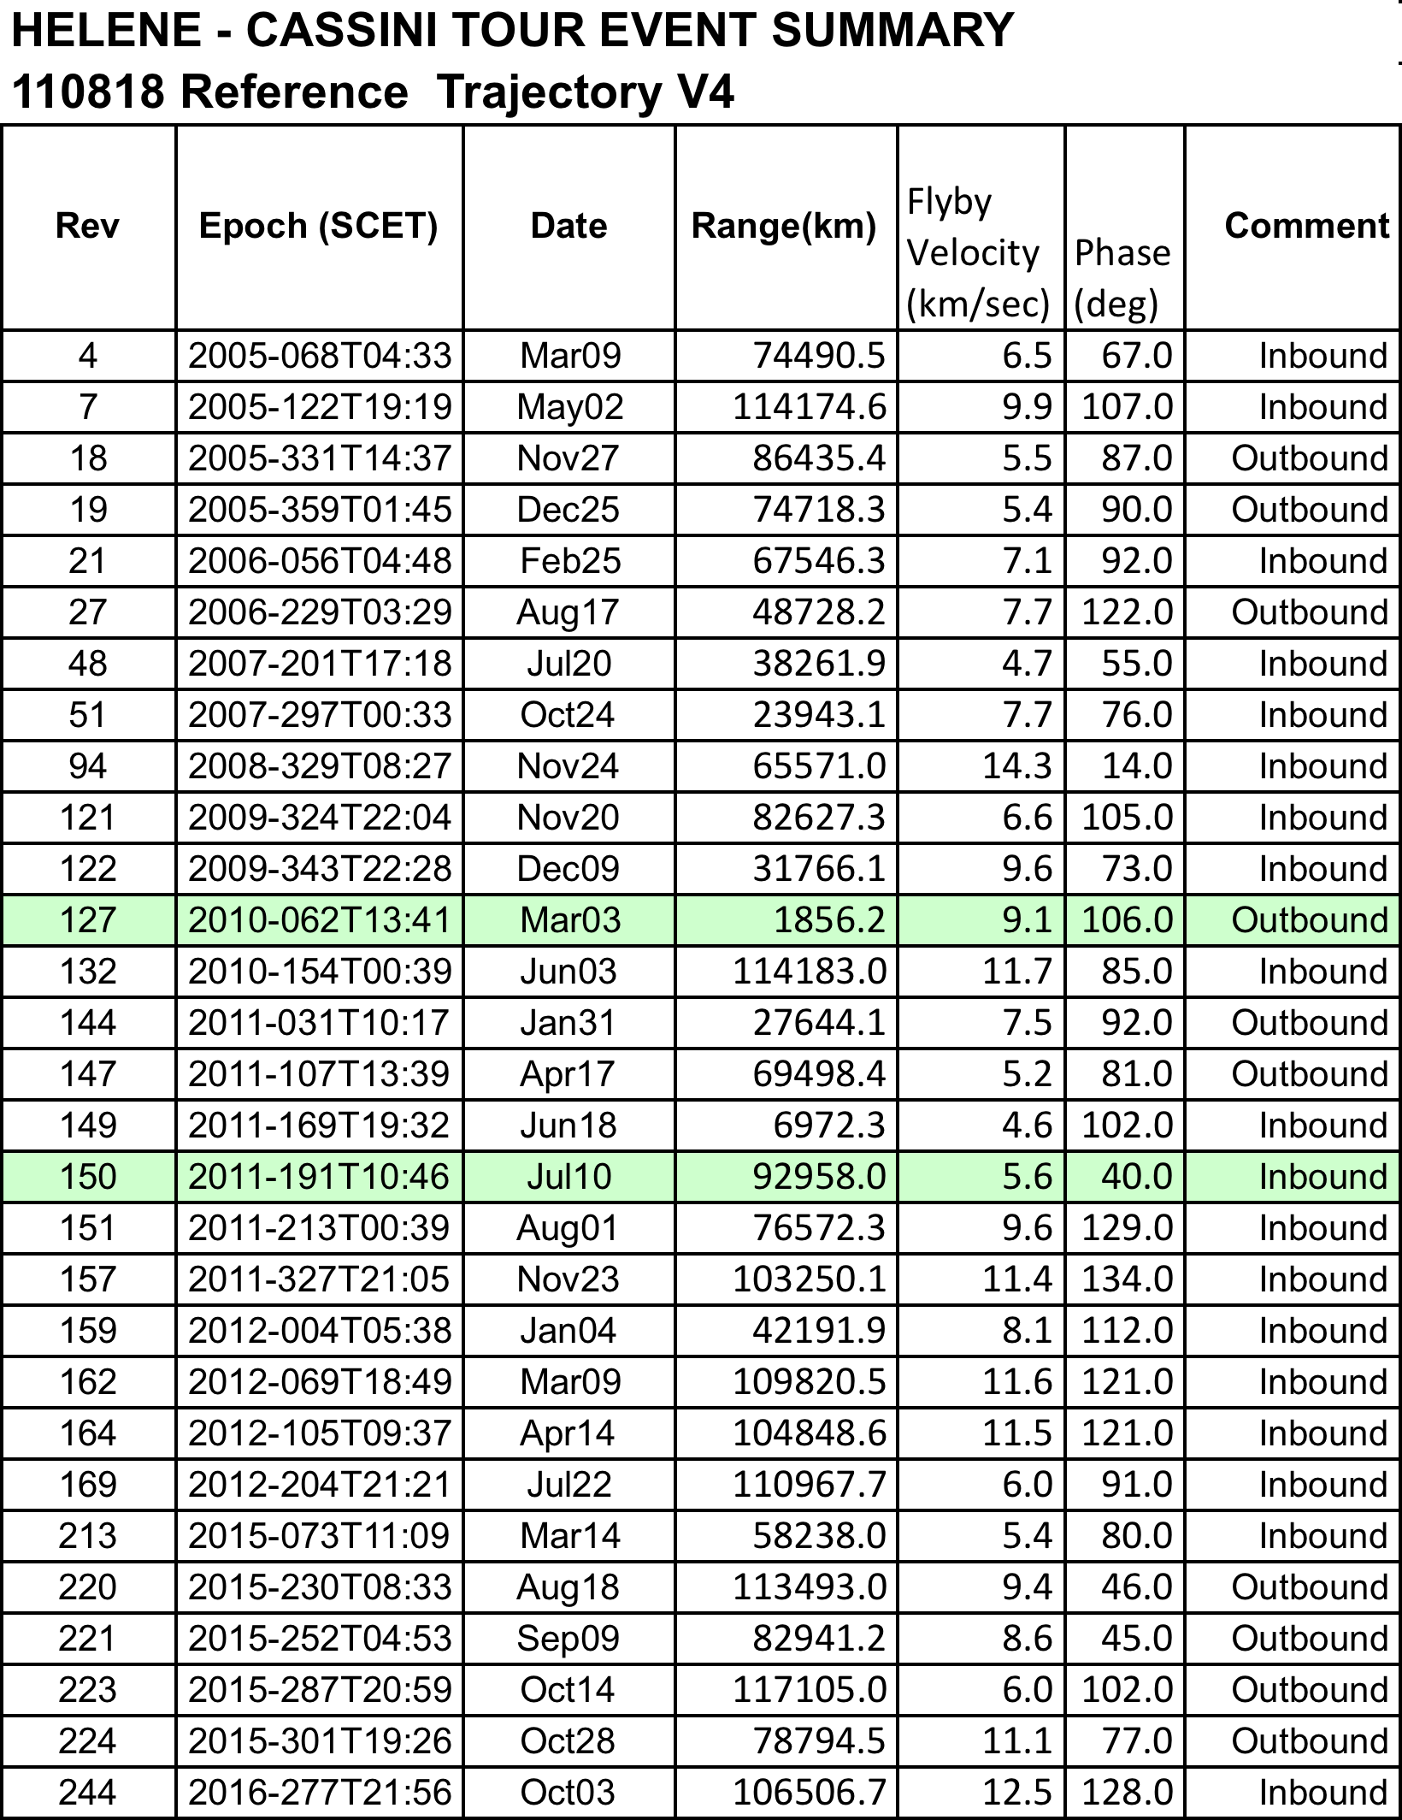

Slide 26
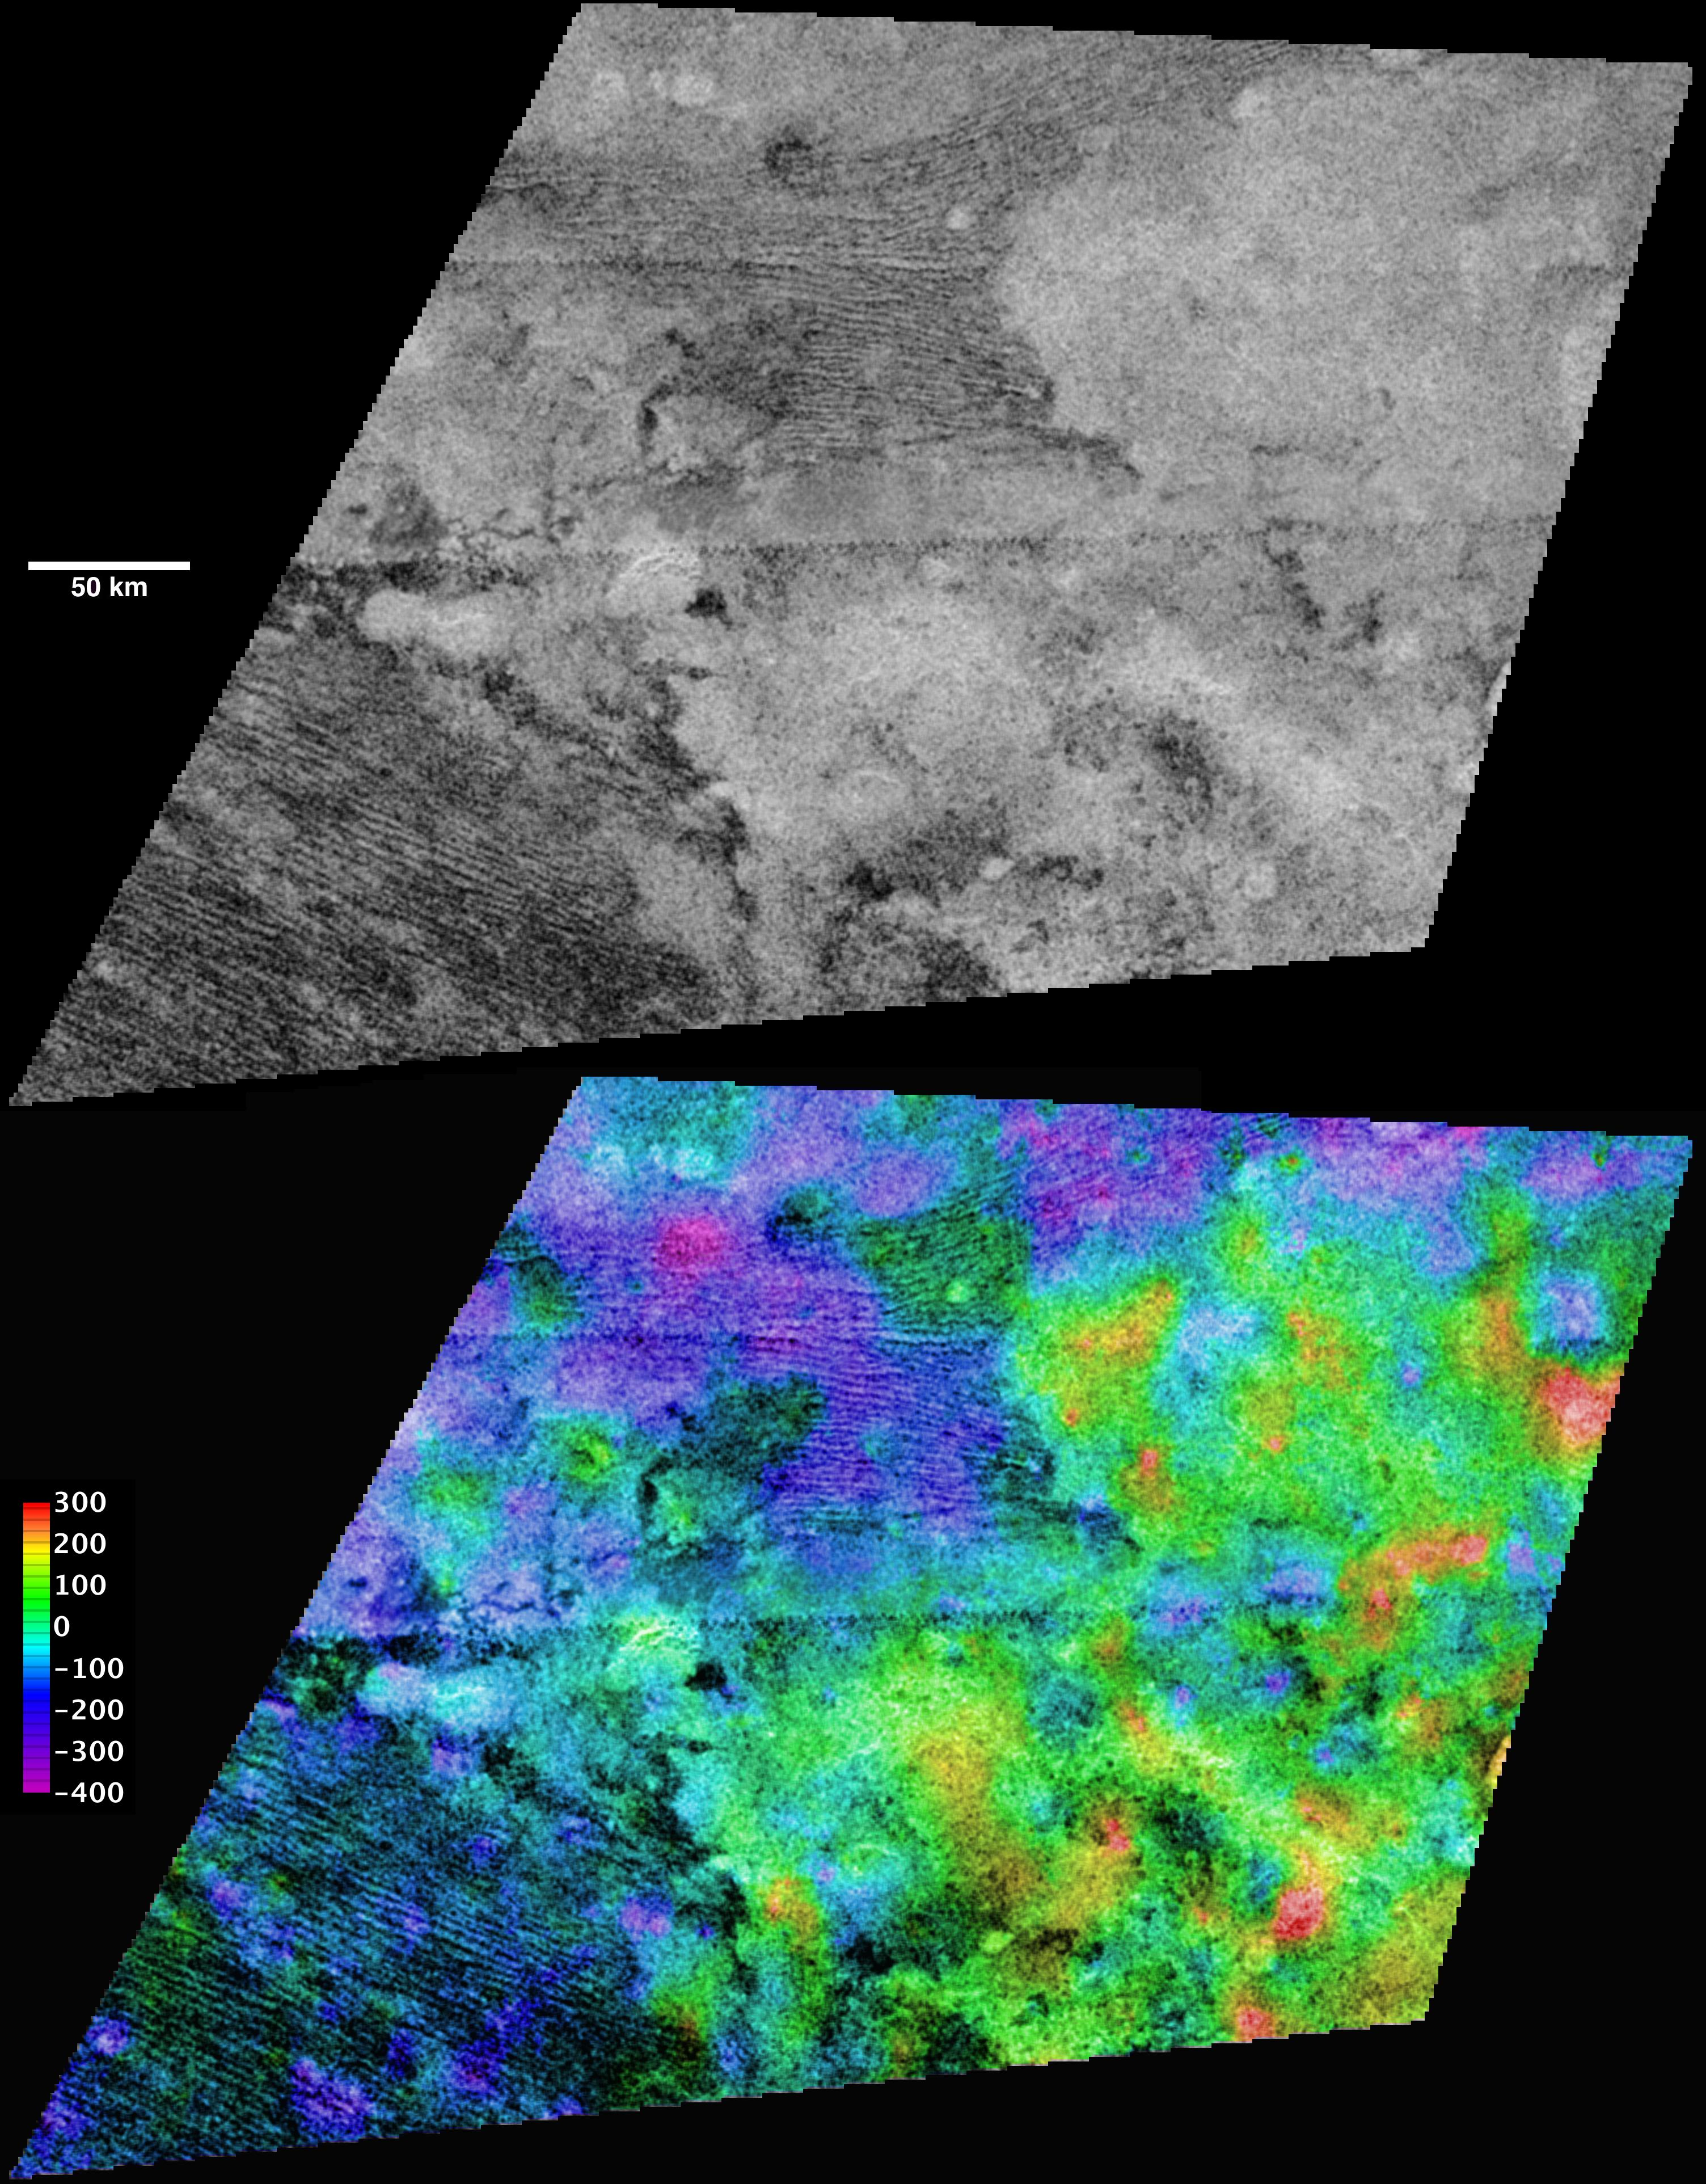
Titan Observations
Titan was systematically targeted throughout the Cassini mission. Observations have been planned to span the period from July 2, 2004 to Apr 22, 2017. Tables are available containing information concerning targeted and non-targeted flyby, solar and earth occultations and graphics presenting information concerning observational sequences for the prime, equinox and solstice missions.
Image PIA11829.jpg
http://photojournal.jpl.nasa.gov/
Observations were made by:
CIRS - Composite Infrared Spectrometer
INMS – Ion and Neutral Mass Spectrometer
ISS - Imaging Science Subsystem
Radar - a Radar instrument
RSS – Radio Science
UVIS - Ultraviolet Imaging Spectrograph
VIMS - Visual and Infrared Mapping
Spectrometer

Slide 27
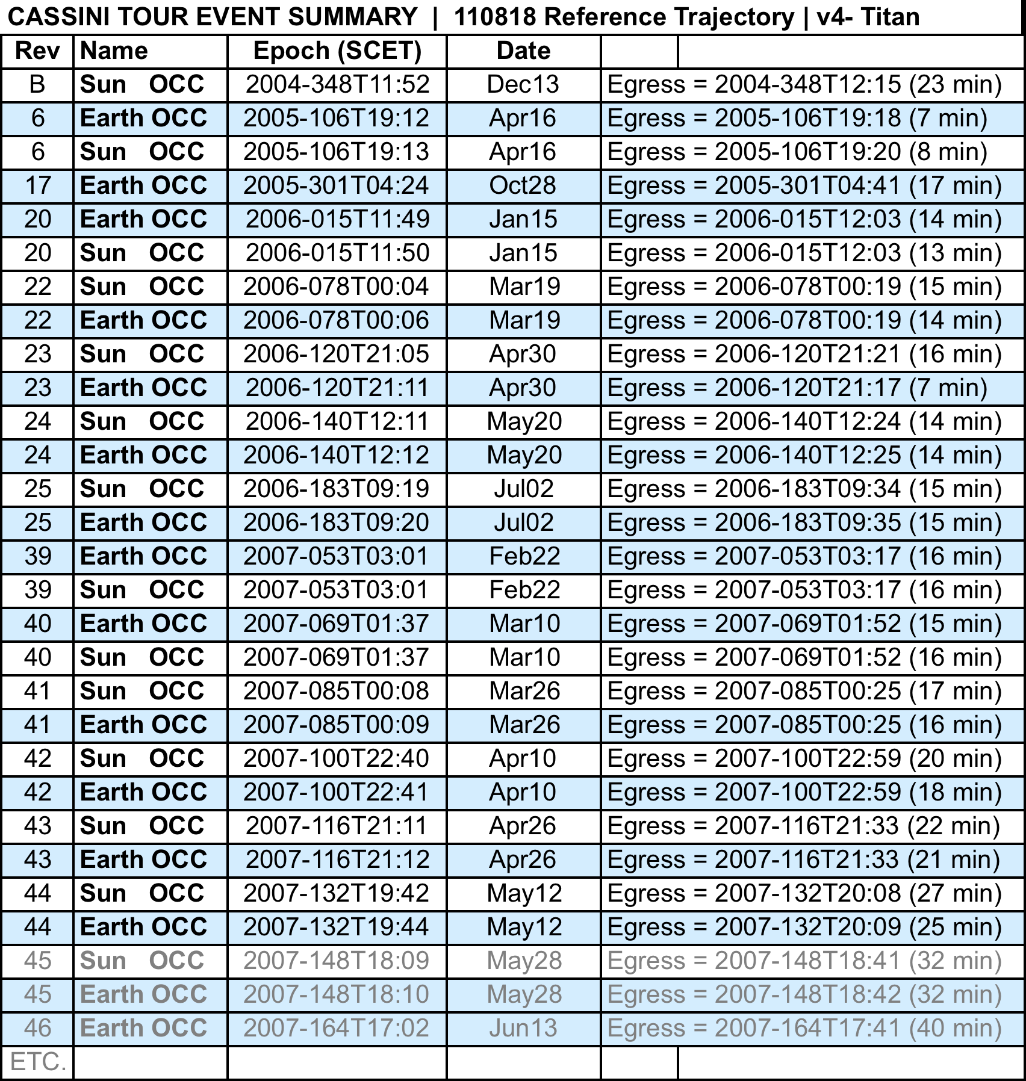
Sun & Earth Occultations of Titan

Slide 28
Titan Planning Summary – Primary Mission

Slide 29
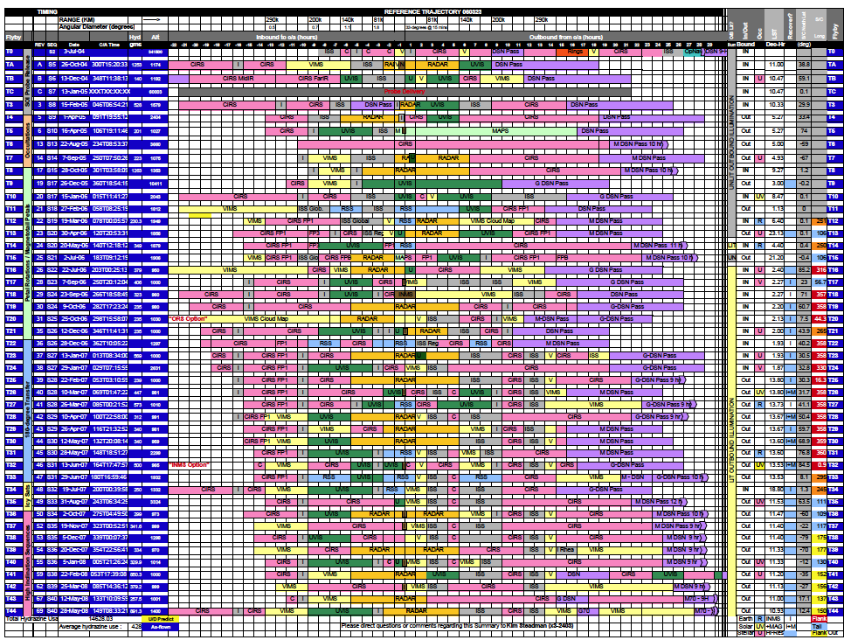
Titan Planning Summary Inset – Primary Mission

Slide 30
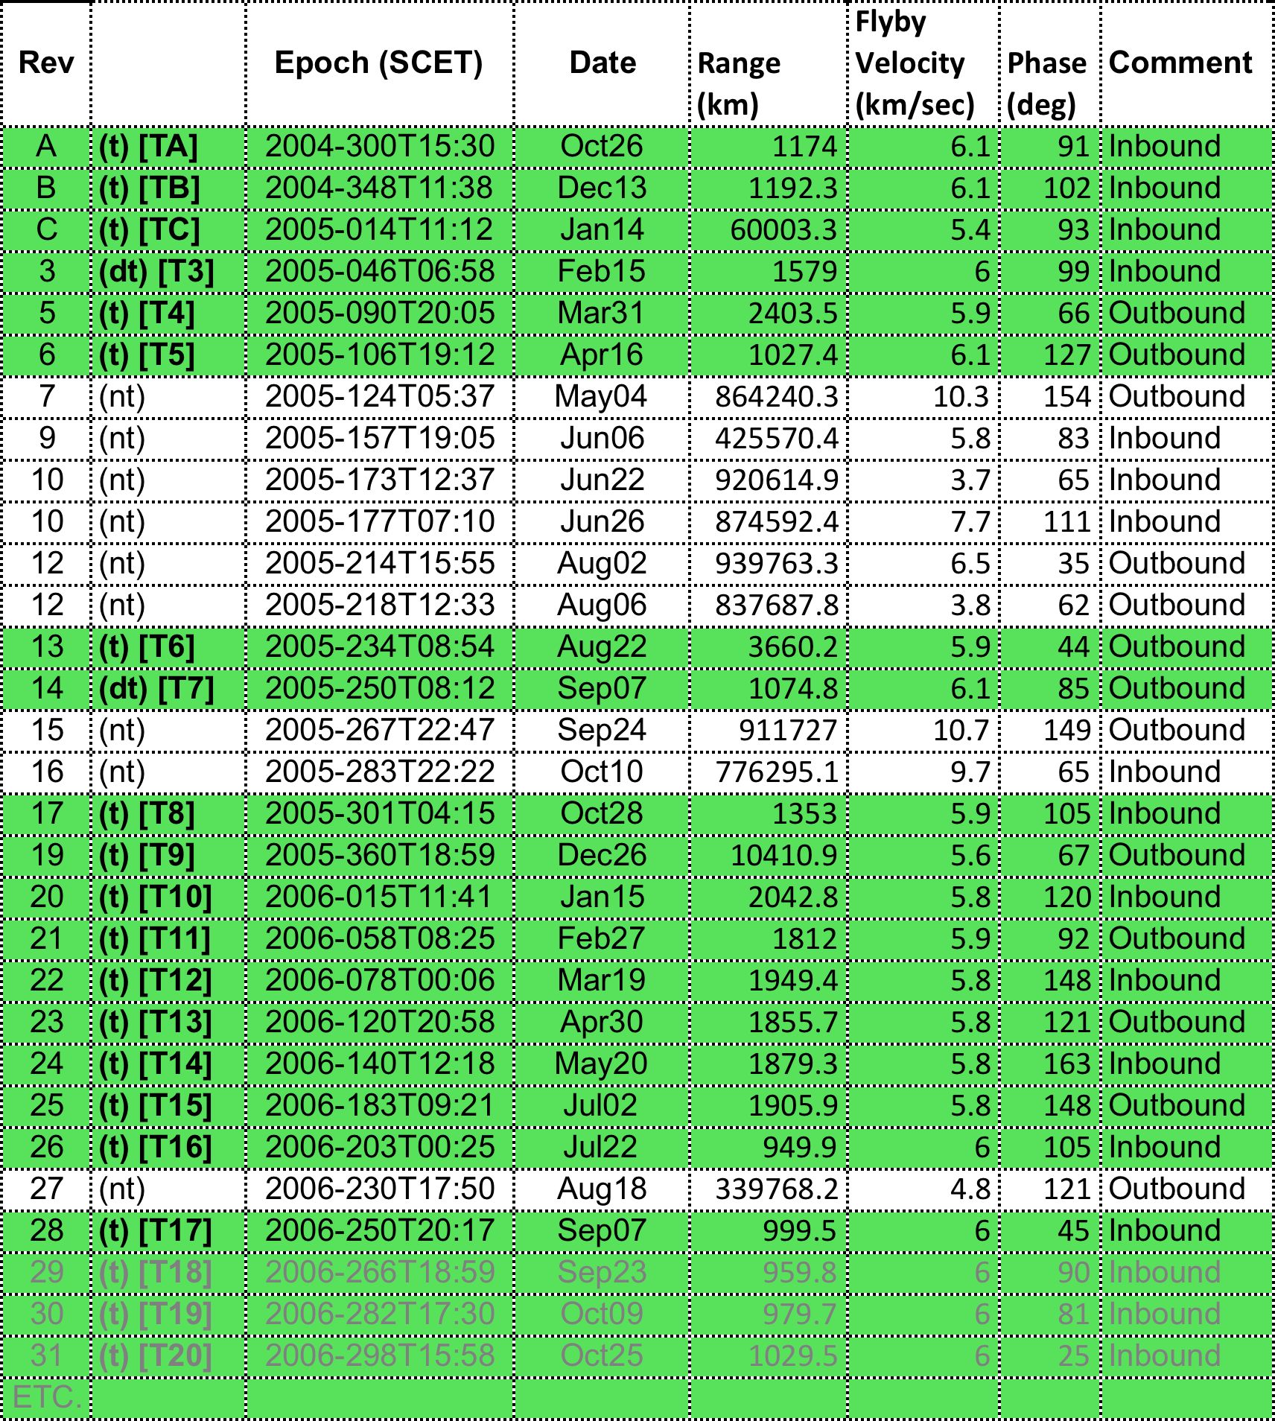
Titan Tour of Events Summary
110818 Reference Trajectory V4

Slide 31
Welcome to Cassini
Jupiter Flyby
Mission Definition
Specific Bodies
Fields & Particles
Apoapse Parameters
Periapse Parameters
Orbital inclination
Ring Plane Crossings
Dust Hazards
Occultations
Tour Plan(s)
Saturn
Rings
Icy Satellites
Rocks
Titan
Bowshock and Magnetopause
Crossings
Intervals when Cassini is
in the Magnetosphere
Orbital Inclinations
Targeted & Nontargeted Flybys
Occultations
Planning sheets
Instruments used
Instrument Information
Users’ Guide
SIS
Etc.
Access to Nodes & Data Sets

Slide 32
Fields & Particles
1. Bowshock and Magnetopause Crossings
Working on this –There is part of this table in MAPS – Have contacted K.C. Hansen who is interacting with MAG to see if we can get an updated table.
2. Intervals when Cassini is in the Magnetosphere
If we get table 1. we can construct table 2.
3. Orbital Inclinations
Orbital inclination plots –Primary, Equinox and Solstice Missions
Apoapse Table contains inclination and range
4. Times when Cassini is within 10 or 15 R_{s}

Slide 34
Sources of data for Jupiter Flyby
CIRS volume cocirs_0306 http://pds-atmospheres.nmsu.edu/cgi-bin/getdir.pl?volume=cocirs_0306&dir=DATA/APODSPEC
UVIS volumes
couvis_ 0001 http://pds-atmospheres.nmsu.edu/cgi-bin/getdir.pl?dir=index&volume=couvis_0001
couvis_0002 http://pds-atmospheres.nmsu.edu/cgi-bin/getdir.pl?dir=index&volume=couvis_0002
ISS and VIMS
Imaging QuickSearch - http://pds-imaging.jpl.nasa.gov/search/search.html#QuickSearch
Rings Node http://pds-rings.seti.org/cassini/

