Slide 1
PDS Radio Science Dick Simpson Stanford University
Overview
Activities
MC Support
PDS-Internal Support (PDS4)
Mission Support
Node and User Support
Local
Near-future Integrated Concern
Changes since last report (and issues deserving attention) have been highlighted in red

Slide 2
People and Resources
3+ People at Stanford
PI Len Tyler (~1% FTE)
Manager Dick Simpson (~33% FTE)
System Software Analyst Ray Jackson (~5% FTE)
Administrative Support
Several Networked Computers and a Telephone
Sun Blade 2000 (NASA/MEX funding: being phased out)
Mac Mini (PDS funding: being phased in)
Library of data, software, and documentation
Funded at ~$150K/year through PDS Management

Slide 3
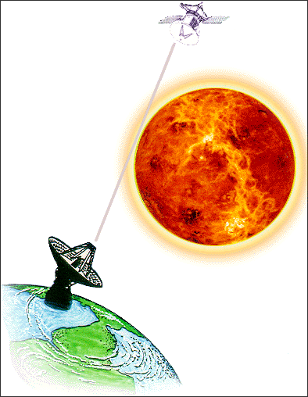
Subject Matter
Use of propagating electromagnetic waves to explore, measure, and understand the universe (more narrowly, the solar system)
planetary surface properties and mapping
atmospheric/ionospheric structure, dynamics
ring structure, dynamics, particle properties
interplanetary plasma, solar corona
spacecraft navigation, ephemeris development
mass estimation, gravity models, interior structure
surface/atmosphere volatile exchange
radio emission
plate tectonics, Earth rotation
gravitational waves, relativity
telecommunication, data management
signal processing, radar imaging

Slide 4
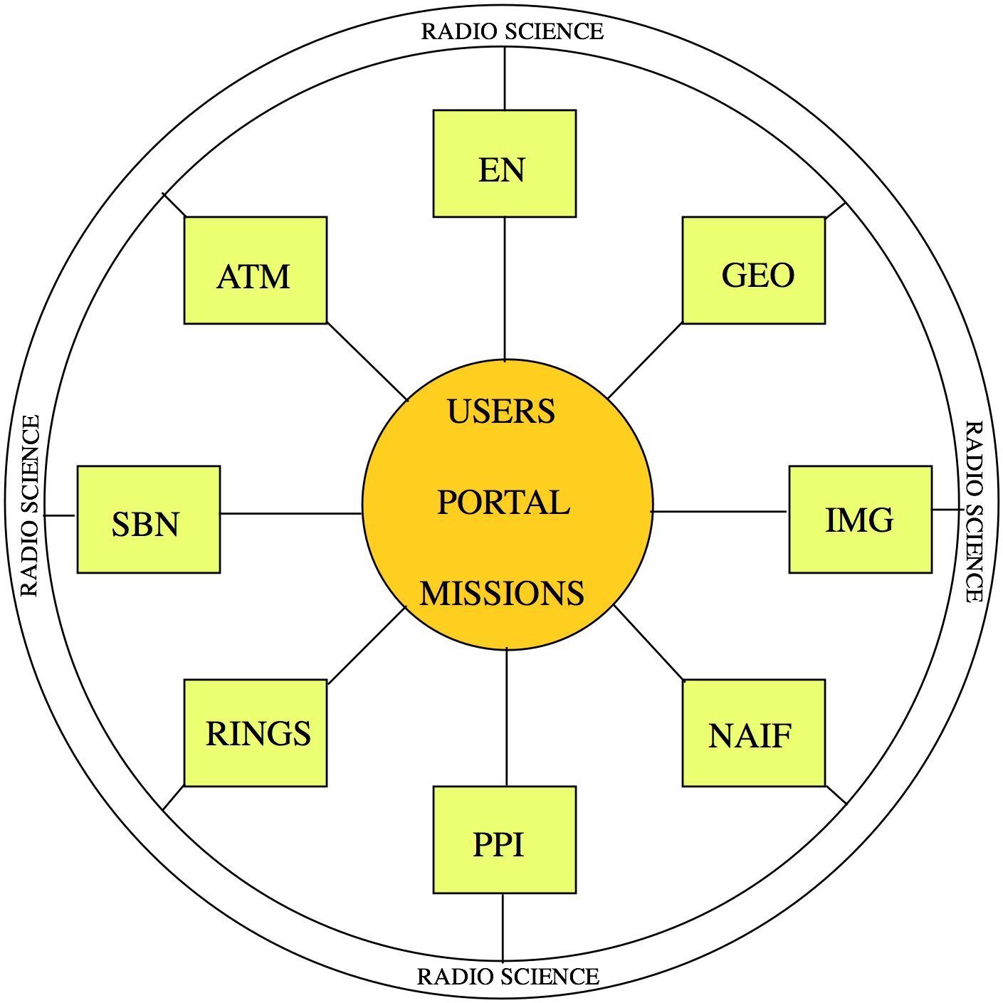
RS Role within PDS
STANDARDS
ATMOSPHERES
SURFACES
INTERIORS
MASS ESTIMATES
RADAR IMAGING
OPACITY PROFILES
TRACKING
NAVIGATION
ASTROPHYSICS
IONOSPHERES

Slide 5
PDS/RS Functions
Advise providers on design of new RS data sets
Review design of new data sets (DN support)
Assist users trying to locate RS data
Assist users with interpretation of RS data
Support PDS MC, Tech Group, and Working Groups
Collect and archive RS data from Mars Odyssey (ODY)

Slide 6
MC Support
(since September 2010)
Management Council Meetings/Telecons
Represent radio science community
Compile, distribute minutes, action items
Draft/edit policy statements
Accumulating/Superseded/Draft data
Processing Levels

Slide 7
PDS-Internal Activities
(since September 2010)
PDS4 Data Design Working Group
Weekly telecons and occasional face-to-face meetings
Data Dictionary scrubs
terse, but meaningful, definitions
consistent usage
definitions for enumerated values
Document writing/editing/review
Data Provider’s Handbook (inactive)
PDS4 Glossary (stable, but will need future upgrade)
Data Dictionary Tutorial (stable, but will need future upgrade)
Jumpstart Guide (stable, but will need future upgrade)
PDS4 Build 1/2 Assessments
Focusing on binary ‘table’ data type for Build 2c tests
Document review
Digestion of results
Face-to-face Tech and DDWG meetings

Slide 8
Mission Support
(past missions)
Magellan Tracking Data Archive (GEO)
Assembled data
Responded to Round 1 Reviews
Awaiting Round 2 review and ingestion
Galileo (ATM)
Cleared liens on GORS_0201 through 0205
awaiting JPL RSST completion of GORS_0206 through 0208
will be first lien-resolved GLL raw RS data fully ingested in PDS
Review process TBD
Many other data sets in restoration queue

Slide 9
Mission Support
(ongoing missions)
MRO – almost no RS activity required (GEO)
MESSENGER – quarterly DAWG telecons (PPI)
LRO Radio Science Archive (GEO)
Reviewed and approved design and example products
Cassini Radio Science (ATM)
Reviewed User Guide concepts; recommended direction
Reviewed initial volume of reduced data (CORS_1001)
2001 Mars Odyssey (GEO)
Archive raw radio tracking data
Monthly deliveries ~15-45 days after acquisition
Mars Express (with NASA/MEX funding)
Archive DSN data to MEX RS PI in Germany
L1/2/3 current through end of 2011
Venus Express (with NASA/VEX funding)
Archive DSN data to VEX Deputy PI in Germany
Archive DSN data to PDS ATM
L1 (and some L2/3) current through 2011
How to get data into public domain (through either PSA or PDS) still TBD
PDS MIWG: participate in monthly telecons (as time permits)

Slide 10
Mission Support
(future missions)
MSL (GEO)
Reviewed APXS design/documents
GRAIL (GEO)
Reviewed Archive Volume and Data Product SISs
Mission is behind after requesting revised schedule
JUNO (ATM)
Reviewed gravity SISs

Slide 11
Node and User Support
(since September 2010)
No RS node or web site
Radio science data are distributed by other nodes
Radio occultations – neutral atmosphere (ATM)
Radio occultations – ionosphere (PPI)
Radio occultations – rings (RINGS)
Bistatic radar (GEO)
Gravity (GEO, SBN)
Gravitational waves/astrophysics (NAIF)
PPI Node Advisory Committee meeting (December)
Various radio tracking data inquiries:
ISRO request for Mars DDOR data

Slide 12
Local Activities
(since September 2010)
Acquired new Mac Mini system
Installed basic system and user software
Need to port and debug QC and archiving software
Sun maintenance ended 31 August
3rd party took over and has responded to one service call
Continuing to archive Mars Odyssey tracking data
Restoration queue remains static
Data from mid-1070s through 1990s
PDS3 vs PDS4?

Slide 13
Near-Future Integrated Concern
Need to port 30 years of software from Sun to Mac (soon!)
Radio science data processing (mostly FORTRAN, some C)
UNIX scripts
QDDB data base supports MGS, ODY, MEX, VEX, and CAS
Transition already delayed 12 months in favor of PDS 2010
Need to develop parallel support for PDS4
Mostly labeling and collection/bundle management
Complex products can no longer have ‘minimal’ labels
Need to make better progress on the restoration queue
PDS support is ~33% FTE + 5% System Administrator
Need help from DNs on PDS4 and restoration activities
Recent track record is not reassuring

Slide 14
Restorations
Apollo bistatic radar (intermediate and reduced)
Mariner 9 and Viking Orbiter 1 and 2 radio occultation profiles (from microfiche)
Arecibo Mars radar (intermediate and reduced)
Viking Orbiter 1 and 2 raw radio tracking data
Viking Orbiter 1 and 2 bistatic radar (intermediate and reduced)
Voyager 1 and 2 data from Jupiter, Uranus, and Neptune/Triton; most of Saturn is done (raw)
Arecibo Galilean satellite radar (raw)

