Slide 1
System Design and Deployment Status
PDS Management Council Face-to-Face
College Park, Maryland
March 27-28, 2012
Sean Hardman

Slide 2
Topics
Build 2b Status
Build 2c Status
Report Service Population
Design Activities for Build 2c and Beyond
System Needs from PDS3 Migration
Next Steps

Slide 3
Build 2b Status
RFA Status
Majority were deferred to Build 2c.
One RFA concerning documentation errors was implemented and delivered.
Delivered and underwent testing at the EN starting in January.
8 new issues discovered and captured.
Catalog migration continues as an iterative process.
There are still a couple of issues to resolve as well as addressing any upcoming data model changes.
Deployment of software in EN Operations.
Plan is to replace current search index with one generated by the PDS4 infrastructure.

Slide 4
Build 2b Status New and Modified Features
Catalog Tool is new for this release supporting ingestion of PDS3 catalog files into the PDS4 registry.
Validate Tool was modified to add support for XML Schema 1.1 and XML Catalogs.
Harvest Tool was modified to keep pace with changes occurring in the PDS4 data model.
Corrected issues discovered during Build 2a testing.

Slide 5
Build 2c Status
New and modified features:
Upgrade the Data Search interface to remove the dependence on the PDS3 catalog database.
Documentation updates based on RFAs and Node Test exercises.
Correct issues discovered during Build 2b testing.
RFA Status
7 Implemented
2 Pending (planned for delivery in Build 2c)
All RFAs concerned documentation and deployment issues encountered during the Node Test exercises.

Slide 6
Build 2c Status Deployment
Engineering Node
Deployment of the core components replacing the central catalog.
Will run side-by-side for six months.
Existing search interfaces reworked to utilize the PDS4 infrastructure.
Discipline Nodes
Deployment of the core components at the Nodes will be phased with this delivery.
Once deployment is complete, Nodes may begin local registration of PDS3 data sets/products with the Harvest Tool.

Slide 7
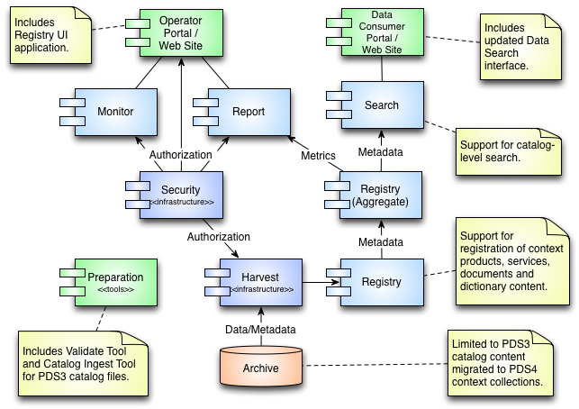
Build 2b/2c Deployment Engineering Node

Slide 8
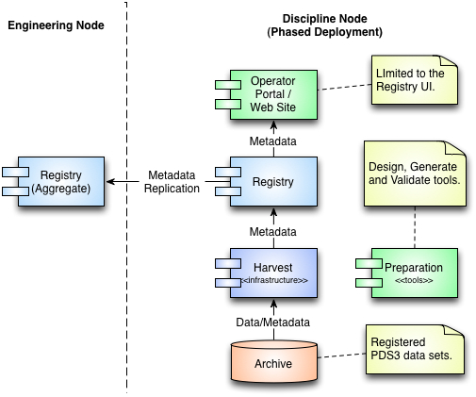
Build 2c Deployment Discipline Node

Slide 9
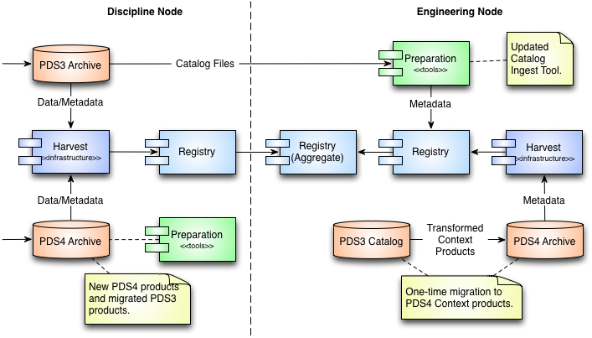
Build 2c Deployment PDS3/PDS4 Product Registration

Slide 10
Report Service Population
Currently working on putting together an inventory of metric sources from the Nodes.
This will help identify logs that may require transformation to the preferred format.
Investigating methods for securely transferring logs from the Nodes to the EN.
Local IT Security requirements may dictate the preferred method.
Also working out a couple of issues with the operational deployment.
Targeting the end of April for full operation.

Slide 11
Design Activities Build 2c and Beyond
Finalization of Search Protocol for the Search Service
The initial protocol has been implemented.
Need to add support for PDAP and VOTable.
Requirements and Design for Transform/Visualize Tools
The desire is to interface with existing functionality where possible (e.g., GDAL).
Integration of PDS4 Infrastructure with Node Operations
Need to work with each Node individually for the best integration approach.

Slide 12
System Needs from PDS3 Migration
So, I keep getting asked what I want from migration or what the priorities should be.
My preference is to get a good cross-section of data products across the Nodes.
The immediate interest is for PDS4 labels that describe products well enough to start implementation of reader/writer capabilities.
Although just as important, the secondary interest is for search-related information (e.g., geometry).

Slide 13
Next Steps
Deploy Search to Operations at the EN.
Work with the Nodes on Report Service Population.
Complete Build 2c Development
Work with the Nodes to deploy Build 2c software locally.
Design and Development for Build 3
Implement data-related tools for transformation and visualization.
Integrate above functionality into PDS search and distribution services.
Replace any remaining software (and its functionality) that is dependent on the PDS3 catalog database.

Slide 14
Questions/Comments

