Slide 1
Build 2c Documentation Plan
Mitch Gordon
March 27, 2012

Slide 2
Goals
Update the documentation prepared for Build 2a to be consistent with the current version of the Information Model and implementation.
Support concurrent prototyping – PDS & IPDA
Quick turn the first revisions of critical sections to support the reviews.
Resolve all outstanding RFA’s associated with the PDS4 Data Standards documentation.
Release the updated documentation for Build 2c.

Slide 3
The Documents
Update the PDS4 Document Set
Include the Information Model
Online access to core definitions
wiki

Slide 4
The Documents Recent Highlights (1)
October 31 – Build 2a
November MC
XML Schema 1.1
Document moratorium
January
Experiments with Schematron
Node testing
Wiki FAQ
Build 2b

Slide 5
The Documents Recent Highlights (2)
February
Adopt Schematron
Start SR updates
Decide to use wiki for more volatile material
March
wiki design
Triage for the DPH
wiki pages initial assignments

Slide 6
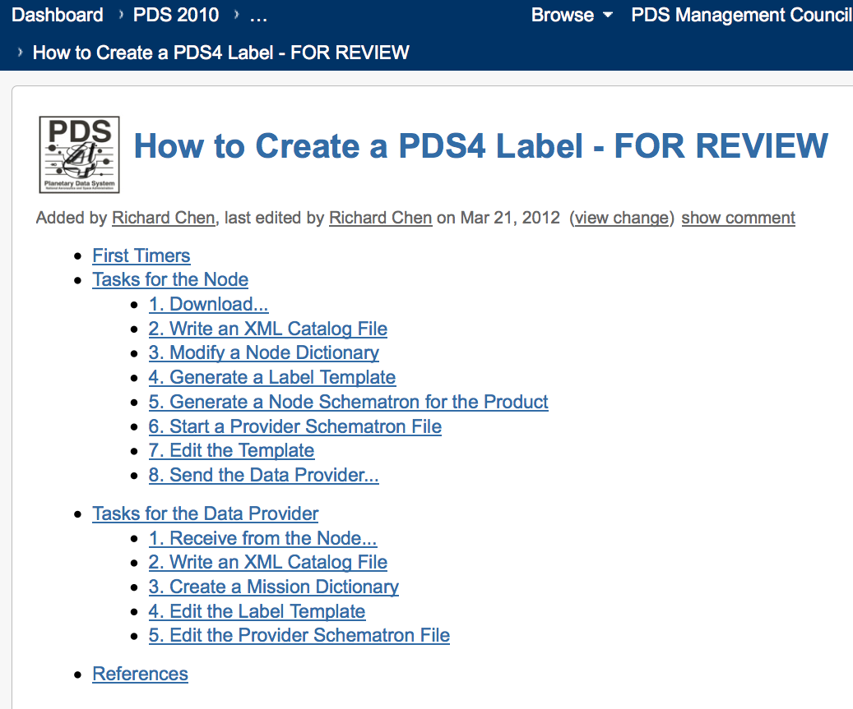
The wiki (1)

Slide 7
The wiki (2)

Slide 8
The Documents Biggest Effort
Standards Reference
DPH
Remove out of date material
Reorganize & revise the remainder
Couple with wiki
Wiki
oXygen centric
Most recent changes to the implementation
LDD methodology
Schematron use
Label design and production

Slide 9
Time Line
Mar 28 – DDWG mini-F2F
Apr 5 – Document section assignments finalized.
Apr 13 – Core definitions accessible online.
– Initial drafts, critical sections for IPDA review
Apr 20 – Draft sections available for review and comment.
May 5 – Revised drafts available.
May 18 – Final documents available for distribution.

