Slide 1
PDS/NSSDC Deliveries
Dave Williams
PDS Management Council
Washington, D.C.
28 March 2012

Slide 2
PDS Delivery Status Overview
PDS Node inputs dataset URLs into PSI, NSSDC opens dataset, updates SIP xman map files, PDS generates SIP manifest, delivers data. NSSDC generates AIPs, archives data collection.
Delivery system running fairly smoothly, some glitches in front end at about the 1% level, typically involve older data sets with some small formatting difference or Oracle issues
Upgrade to JIMIX planned for April, this will solve most of the front end problems we are currently encountering

Slide 3
PDS Delivery Status Overview
Back-End (Data Delivery) Problems
Still having difficulty with deciding how to deliver very large data sets
Electronic delivery too slow for large data sets
Data “Toasters” good up to 9-12 TBs
Planning to try out NAS System delivery with Imaging Node

Slide 4
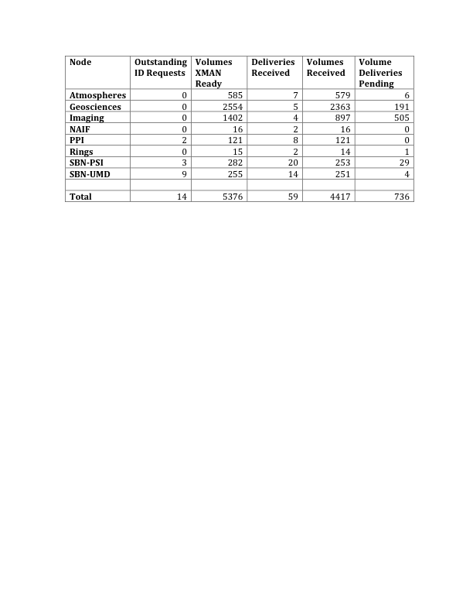
PDS NSSDC Delivery Status

Slide 5
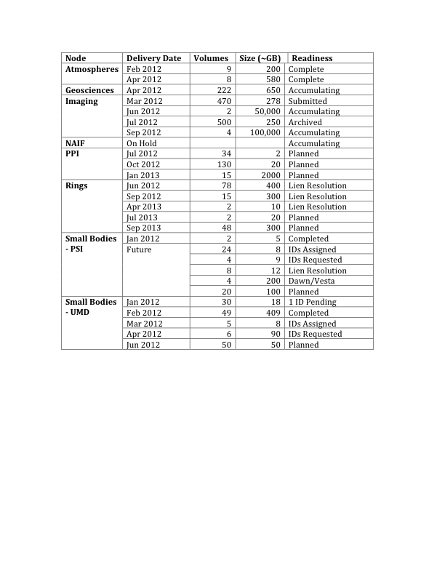

Slide 6
Deep Archive of PDS4 Data
PDS4 will present new challenges for the transfer and deep archive of data at NSSDC. A group comparable to the NDWG which planned the transfer of PDS data to NSSDC will probably be necessary to understand the differences in data formats and make the necessary arrangements for transfer of PDS4 data.

Slide 7
Accumulating Data Sets
Pending drastic budget cuts to NSSDC will make it difficult for us to archive large accumulating data sets from PDS. NSSDC may only be able to accept the final data sets from instruments producing large amounts of data.

