Slide 1
Dawn Coordinate System
PDS Management Council
28 March 2012
Mike A’Hearn

Slide 2
PDS Standards
PDS Standards Reference (Feb 2009), Chapter 2: Cartographic Standards
"All data providers for PDS products should follow accepted standards and be aware of current NASA and international recommendations on cartographic coordinate systems and conventions relevant to their bodies of interest.”
"The primary international body for coordinate systems in the Solar System is the International Astronomical Union (IAU)... [discussion of celestial coordinates follows]”
"For cartographic coordinates and conventions for planets and satellites, the IAU and the International Association of Geodesy (IAG) have established jointly the Working Group on Cartographic Coordinates and Rotational Elements (WGCCRE), which publishes triennial reports, currently in the journal Celestial Mechanics and Dynamical Astronomy (Davies, et al., 1980, 1983, 1986, 1989, 1992, 1996; Seidelmann, et al., 2002, 2005, 2007). This working group includes PDS-affiliated scientists, thus assuring full interaction in defining the standards. Publications and reports issued by the WGCCRE can be found at http://astrogeology.usgs.gov/Projects/WGCCRE/. PDS data providers should refer to these reports for current information and recommendations on rotational elements for Solar System bodies and how these are related to their cartographic coordinates.”

Slide 3
IAU WG Standards
Archinal et al., 2011, Cel. Mech. Dyn. Astr., 109, page 106)
“The Working Group would like to emphasize - as it did in the introduction to its first report (Davies et al., 1980, page 73) - that once an observable feature at a defined longitude is chosen, the longitude definition origin should not change except under unusual circumstances (such as perhaps a change in or loss of the feature). This implies that once such a feature has been adopted, a return to a value of W0 defined by some other method (e.g. the principal axes of inertia for resonantly or synchronously rotating bodies such as Mercury (Margot, 2009), or Jovian or Saturnian satellites) should be avoided. Note, however, that this does not preclude the use of smaller or more precisely determined features, multiple features, or even human artifacts to define longitude - as long as the original definition is maintained to within the accuracy of previous determinations.”

Slide 4
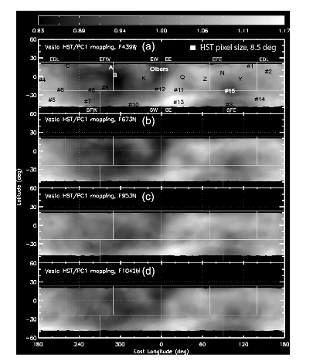
Previous Publications
Thomas et al. 1997 Icarus 128, 88
Defines Olbers Regio as 0°
Li et al. 2010 Icarus 211, 528
HST observations
Maps showing Olbers Regio at 0° longitude

Slide 5
Dawn Maps

Slide 6
History 1
Summer 2011 – informal discussions between PI and Chairman of IAU WGCCRE about changing coordinates on Vesta
Referred to WG publications with recommendations
Change polar orientation and rotation rate but keep zero-point of longitude
7 Sep 2011 – Official request to WG to change longitude
13 Sep: Call for vote; 10.5:2:1:1 against. First time in memory that WG carried out official vote other than at IAU GA
14 Sep: PI responds – too late to change
3 Oct 2011 – DPS talk by PI cites non-IAU coordinates
4 Oct 2011 – SBN Advisory Council (@ DPS)
No waiver, insist on IAU guidelines
5 Oct 2011 – Suggest PI meet with SBN
Not necessary, IAU will change its mind

Slide 7
History 2
?day? Oct 2011: Informed Dawn DAWG at weekly telecon that SBN would not review data in current coordinate system
10 Nov 2011 – DAWG telecon states project will proceed with Claudia system
SBN will not send data to peer review
1 Dec 2011 – A’Hearn & Joy agree on compromise thought to have been approved by PI
12 Dec – PI says no compromise agreed to – see next slide
~18 Dec 2011 – Dawn proposal to HQ on why Dawn is right
Nobody is convinced at HQ or several external reviewers
6 Jan 2012: 1 hr telecon – A’Hearn, Russell, Raymond, Sykes
No progress

Slide 8
What Was the Compromise
All Vesta-centric coordinate keywords are in Olbers-based system
Local Data Dictionary contains Dawn-Specific coordinate keywords in Claudia-based system
Net difference between systems:
Claudia longitudes = Olbers longitudes – 220°

Slide 9
History 3
12 Jan 2012: HQ Directive to Dawn to archive in Olbers-based system
23 Feb 2012: Telecon HQ & Dawn
HQ directed Dawn project to not bother IAU WG any more
Per email from HQ to A’Hearn & Archinal
25 Feb 2012: New request from Dawn PI to WG CCRE
Under discussion by WG – sentiment running negative as of today
Feb-Mar 2012: Data being delivered to SBN with compromise from 1 Dec 2011
No public SPICE kernels in Olbers system
SBN will not make data public until public SPICE kernels are Olbers-based
23 Mar 2012: Long mtg @ LPSC - Archinal, Russell, Raymond
No progress
25 March 2012: New request from Dawn PI to WG

Slide 10
Possible Future Path
Date TBD – NAIF posts correct PCK
1st Week May – SBN Peer Review Completed for Approach through HAMO RAW data from FC & VIR & GRAND
May – Dawn SDC reruns data for VIR & FC, submits to SBN for archiving, makes data public
June – August – Data deliveries continue with configuration controlled pipeline, i.e. accumulating datasets
August – IAU WG, having decided to NOT address the issue until then, meets at IAU GA and decides not to change policy
Early 2013 – SDC delivers calibrated data and derived products
Does the argument start over? I.e. will we allow both longitudes to be on archived maps?

