Slide 1
Non-Digital Data at NSSDC
Dave Williams
PDS Management Council
Washington, D.C.
28 March 2012

Slide 2
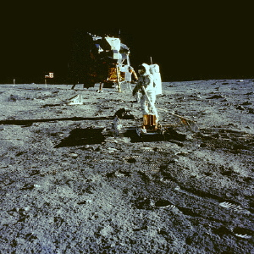
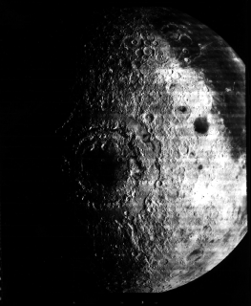
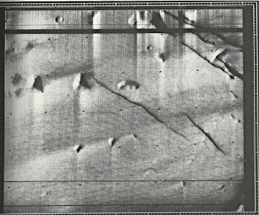
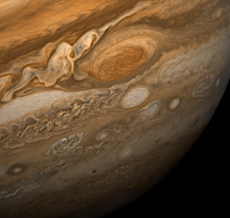
Photographs

Slide 3
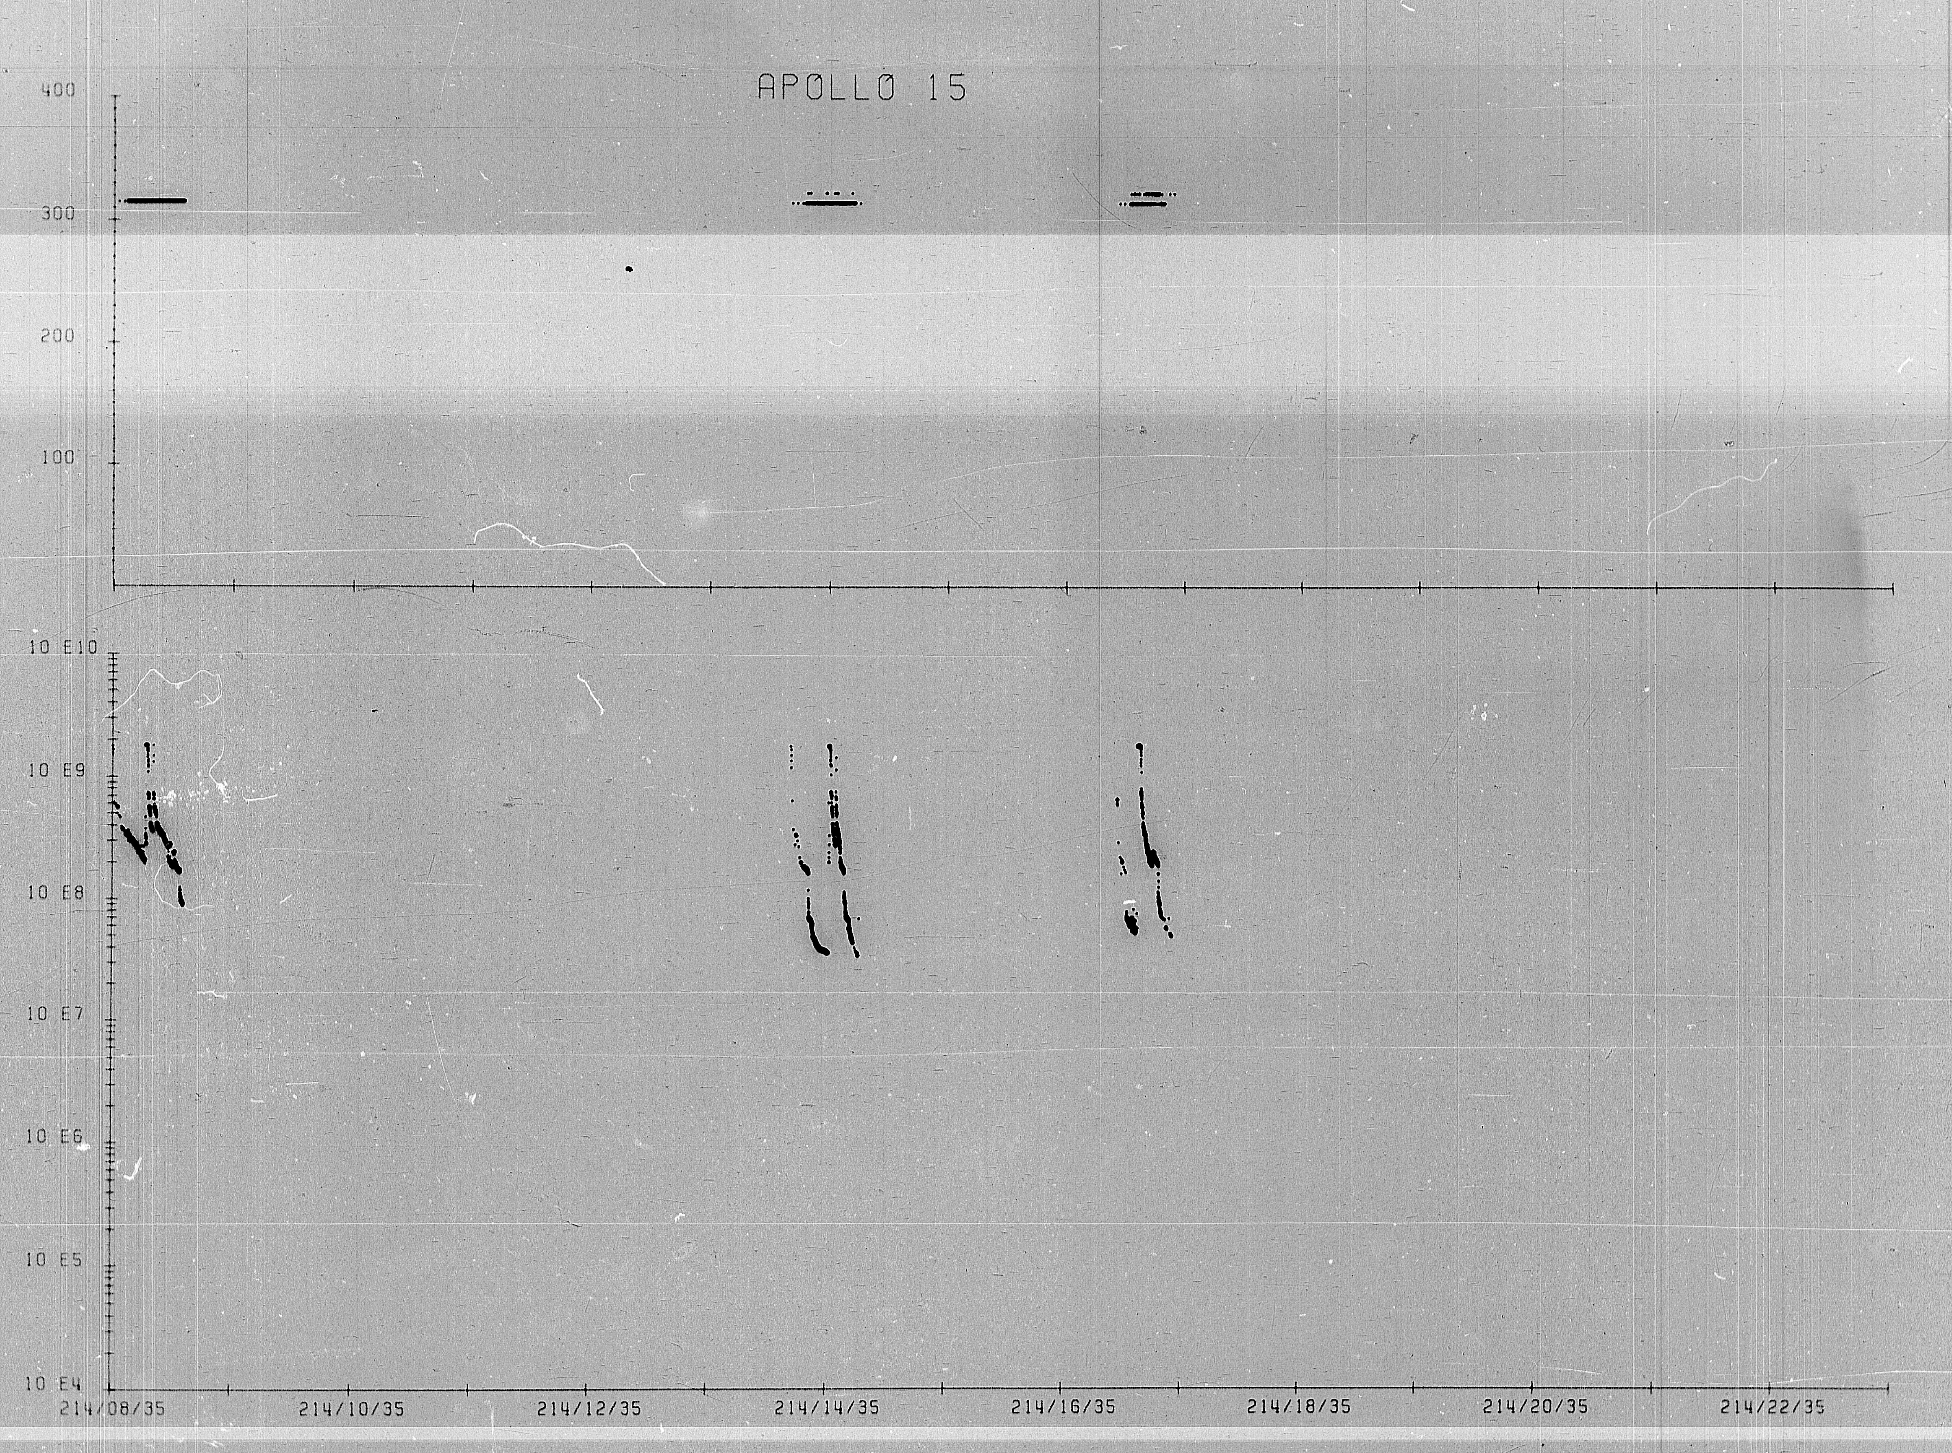
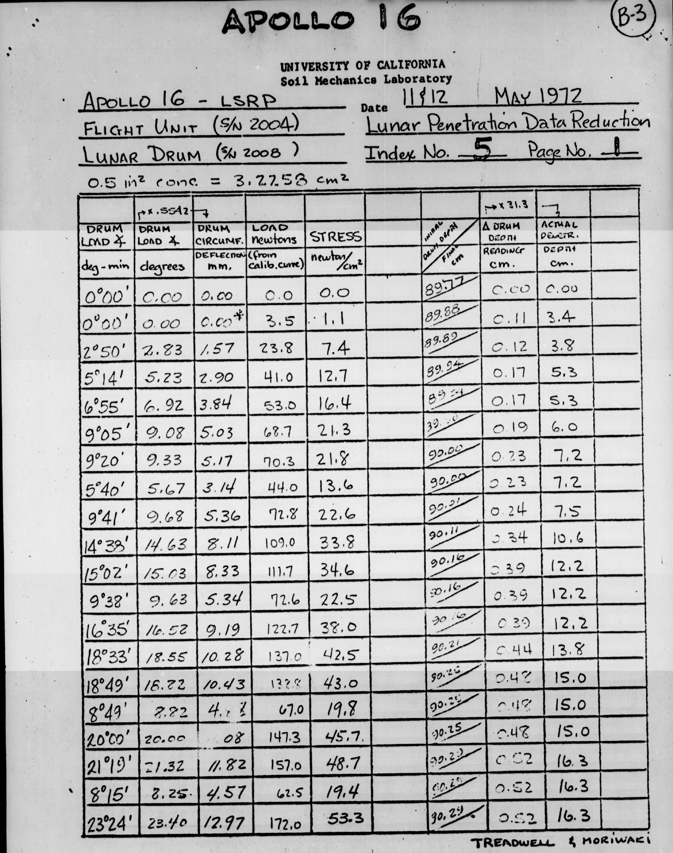
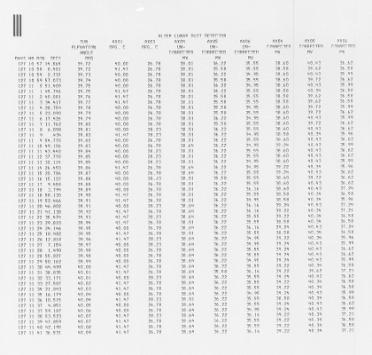
Microfilm/Microfiche

Slide 4
Non-Digital Data Archive
NSSDC currently has large holdings of hard-copy planetary and lunar data collected over 40 years, including:
410,000 ft of photographic film, 335,000 cut frames, and 180 reels of movie film
231 unique microfilm data collections comprising 2036 reels of microfilm
178 unique microfiche data collections comprising 11,147 microfiche cards

Slide 5
NSSDC Analog Archive
Discipline | Microfilm (reels) | Microfiche (cards) | Film (ft) | Film (frames) | Movie (reels) | Maps | Slides
Astrophysics | 2357 | 5963 | 100 | 11975 | 0 | 0 | 62
Earth Science | 55 | 773 | 13067 | 64610 | 4 | 0 | 0
Planetary | 2036 | 11147 | 409081 | 335053 | 181 | 1773 | 768
Space Physics | 34589 | 30507 | 580 | 6173 | 2 | 0 | 36893
Other | 3224 | 3624 | 3785 | 6206 | 20 | 0 | 2112
Totals | 42,261 | 52,014 | 426,613 | 424,017 | 207 | 1,773 | 39,835

Slide 6
Non-Digital Data Request Examples
Viking Gas Exchange Biology Experiment data requested (Tufts University). Only known set of these data held on 14 microfilm reels at NSSDC. The Labeled Release data on these reels was previously converted to a PDS data set. Plan is to scan the GEX and Pyrolytic Release data from microfilm
Viking 2 Seismograms were requested (JHU-APL) for the Insight Discovery Phase-A effort. They were scanned from microfilm.

Slide 7
Plans for Non-Digital Archive
NSSDC has been tasked to end support of its non-digital archive and release its hardcopy holdings. Since these represent some of the best working copies of lunar and planetary photography and unique data on microform we are attempting to dispose of these in a way that they won’t be lost to the scientific community.

Slide 8
Site visits and telecons with the National Archives and Records Administration
Working on estimates of storage costs with Iron Mountain
Data holdings being reviewed by PDS
Possibility of saving high-priority data sets for digital scanning
Clarification of NASA data retention policies

